Slide 1

Scheduling – External Training
Notes:
External user access to the system is scheduled for this Monday (May 22nd). Users will be allowed to nominate for June 1st forward in connect, but any day prior should be done in Dart.
The nomination deadline will be moved 15 min back to meet the NAESB standard instead of the extra 15 min that Kinder previously provided and this is reflected in our modified tariff.
If you have any questions about needing new user access or having Ruby added to your current access, you can e mail sarah.starke@tallgrass.com. She should be able to get that sorted for you!
I would also like to preface with the fact that, if you already have access to connect, and do business on our other pipes, a lot of this will be stuff will look very familiar and may be a review.

Slide 2

External Training
Why are we doing this?
  NAESB compliance
  System improvements and functionality
  Uniformity throughout the Tallgrass Pipes

Slide 3
External Training
Navigation – Tallgrass QPTM PRD
Nominations
Confirmations
Reports
Miscellaneous

Slide 4

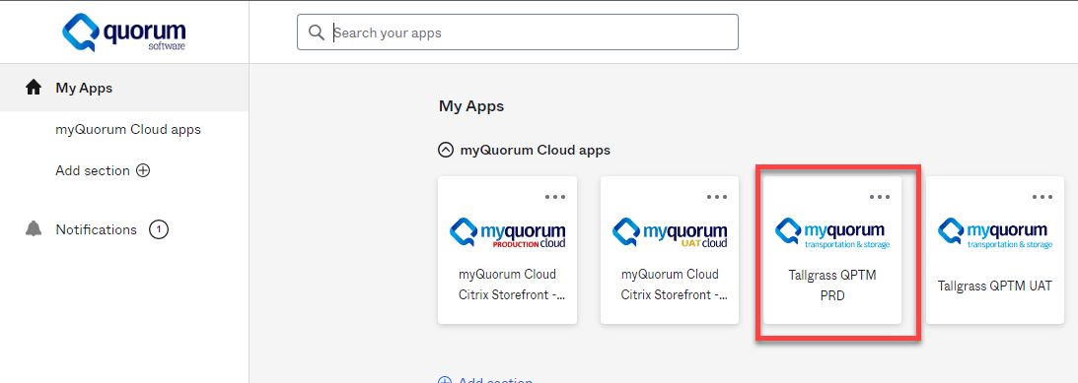
Navigation
  Tallgrass QPTM PRD is the new Web based application
Click to Return to Index

Slide 5
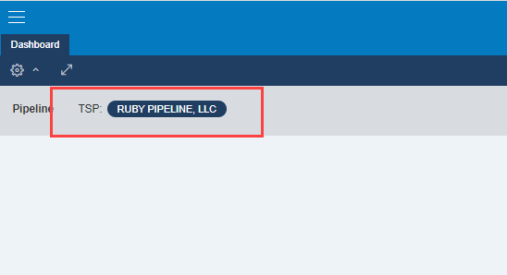
Tallgrass QPTM PRD
Initial screen is the Dashboard
Dashboard will consist of Widgets that have been defined for your user role for a particular TSP
Widgets may include items such as Nominations, Confirmations, quick links to other screens, etc
The Dashboard allows user to set a default TSP. If the screen you are on does not display the TSP, the Dashboard TSP is the default.
TSP Selection
Click to Return to Index

Slide 6
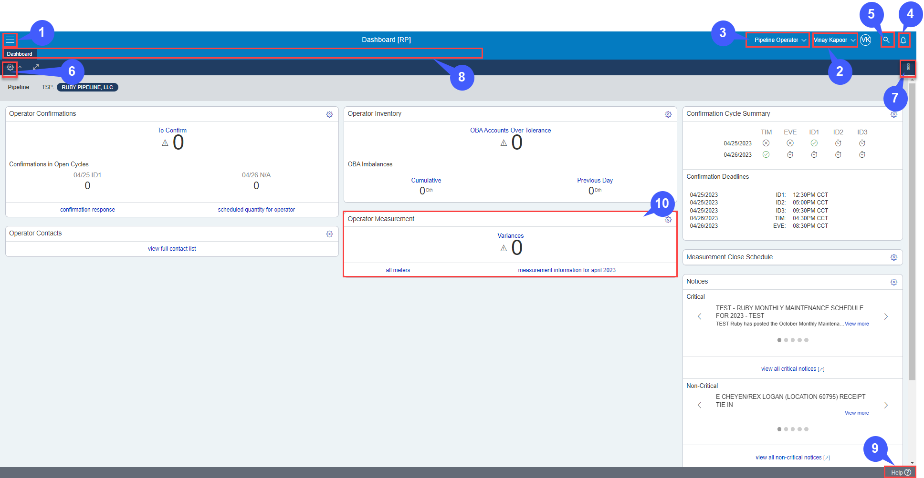
Dashboard
Notes:
Menu/Sitemap: Provides basic navigation
User Menu: Displays your username. Access to My Profile – Settings and Sign Out options
Persona: Allows for different dashboard views
Alert: Displays the number of recent alerts. All recent alerts, including errors, warnings, and information are stored in the Alert Center
Site Search: Click on the Search icon to prompt the Search Bar
Context Data Filter: Sets Pipeline, Company, and Plant
Overflow Menu: Allows customization of the dashboard
Open Screens: Displays sessions/tabs in progress
Help: Provides access to the myQuorum help
Widgets: Provides Summary information on key data
NOTE: Do not duplicate web tabs. Instead, right click and select “open link in new tab”

Slide 7



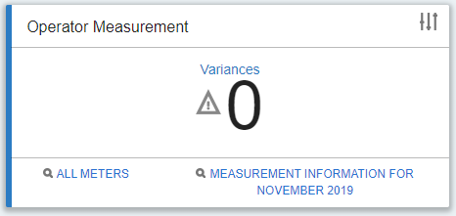
Dashboard Cont.
Menu/Sitemap: Provides basic navigation
User Menu: Displays your username. Access to My Profile – Settings and Sign Out options
Persona: Allows for different dashboard views
Alert: Displays the number of recent alerts. All recent alerts, including errors, warnings, and information are stored in the Alert Center
Site Search: Click on the Search icon to prompt the Search Bar
Context Data Filter: Sets Pipeline, Company, and Plant
Overflow Menu: Allows customization of the dashboard
Open Screens: Displays sessions/tabs in progress
Help: Provides access to the myQuorum help
Widgets: Provides Summary information on key data
NOTE: Do not duplicate web tabs. Instead, right click and select “open link in new tab”

Slide 8

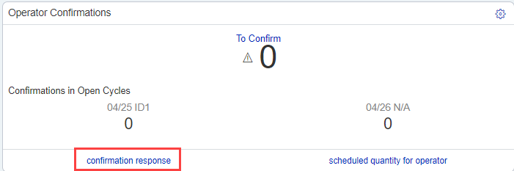
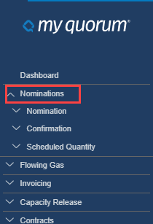
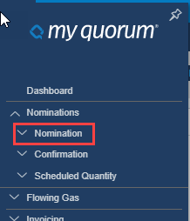
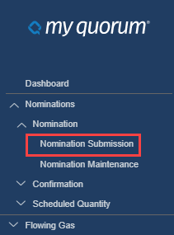
Screen Navigation
Use the search tool
Widget links
Use the Side Menu/Site Map

Slide 9
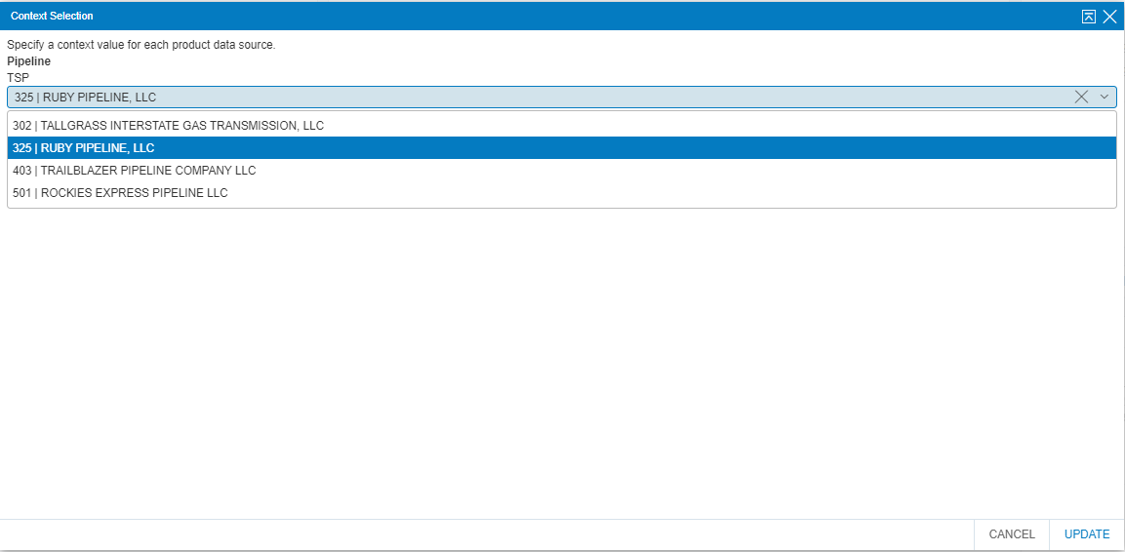
Tallgrass QPTM PRD
Click on existing TSP to change TSP
Click to Return to Index

Slide 10
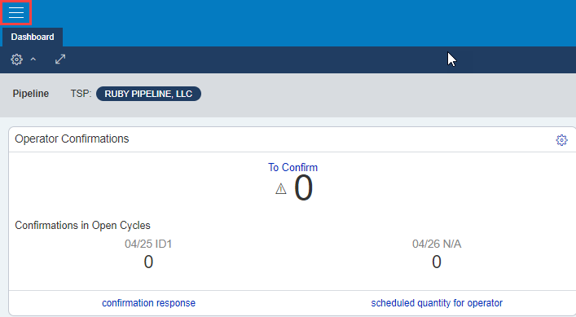
Tallgrass QPTM PRD
When selecting the three lines, this allows the user to access to other screen sets: Dashboard, Pipeline and eSuite
Click to Return to Index

Slide 11
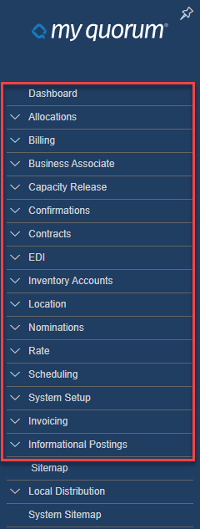
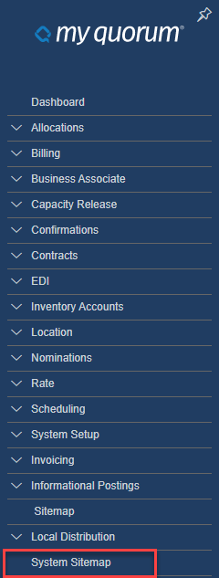
Tallgrass QPTM PRD
Most screens are under the default menu
eSuite contains all reports and can be found under the System Sitemap
Click to Return to Index

Slide 12
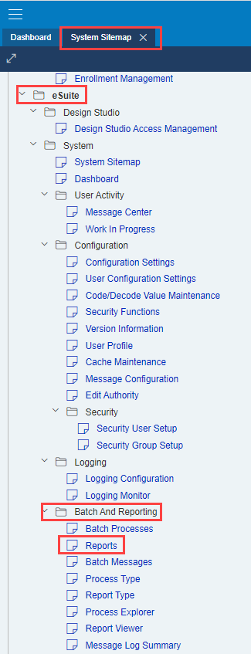
Tallgrass QPTM PRD - eSuite
System Sitemap→ eSuite→ Batch and Reporting→ Reports
Click to Return to Index

Slide 13
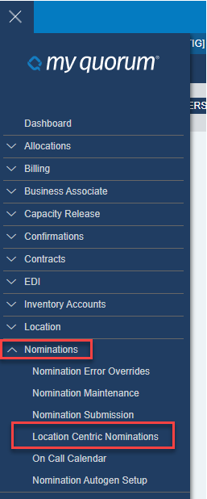
Nominations – Loc Centric
Click to Return to Index

Slide 14
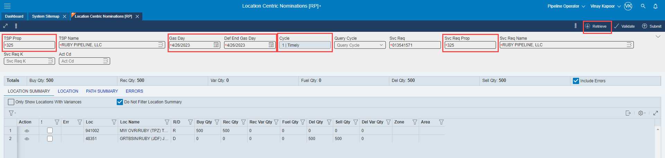
Nominations
After entering header information, select retrieve
Click to Return to Index

Slide 15
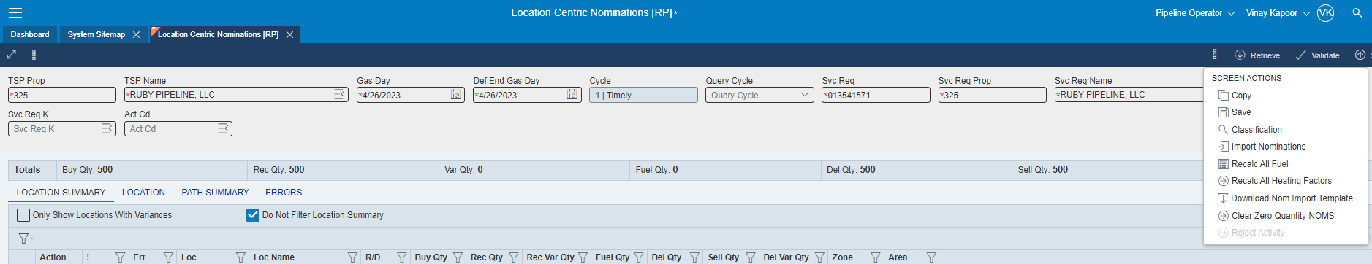
Nominations
The More Actions option will have different functions on different screens, such as Push for all Up/Downs on some screens
More Actions Options to copy, save, recalculate fuel, etc.
Click to Return to Index

Slide 16
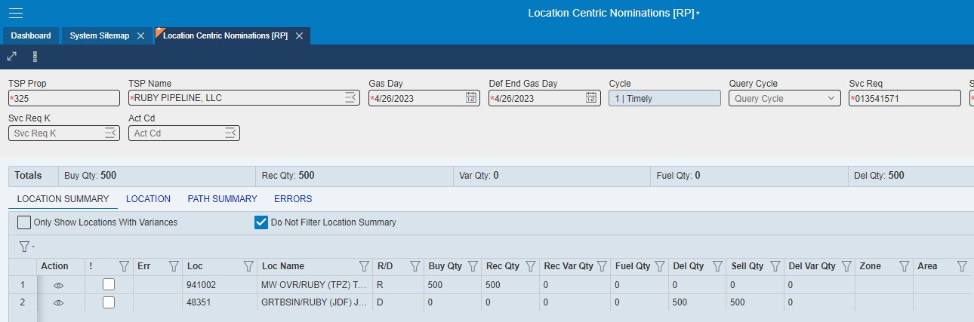
Nominations
Check box to see all locations with noms (default in our current version of Connect)
To manually enter location
(noms at new location)
To enter a location w/noms
Click to Return to Index

Slide 17
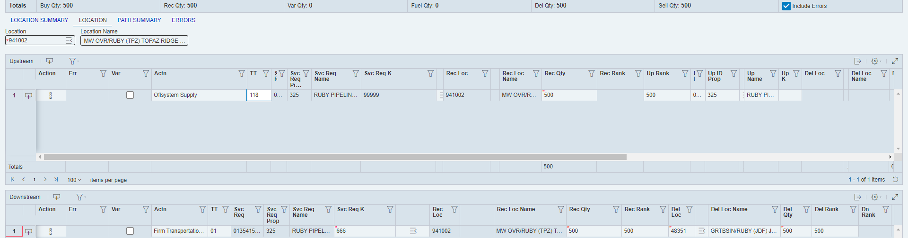
Nominations
Enter or search location
Add a new line item
(All other functions are almost identical to our current version of Connect in Location Centric)
If you want drill down to the location
If you want to track the path
Click to Return to Index

Slide 18
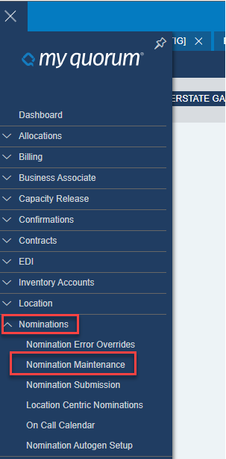
Nominations – Nom Maintenance
Click to Return to Index

Slide 19
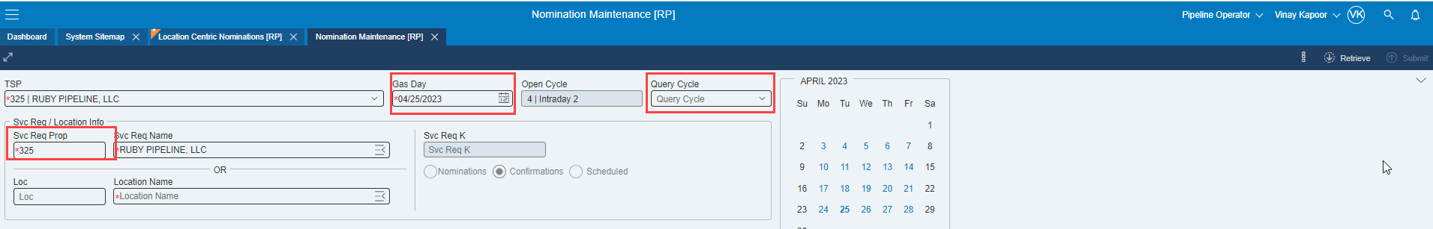
Nominations – Nom Maintenance
Similar to Connect, select retrieve after entering in required info
Click to Return to Index

Slide 20
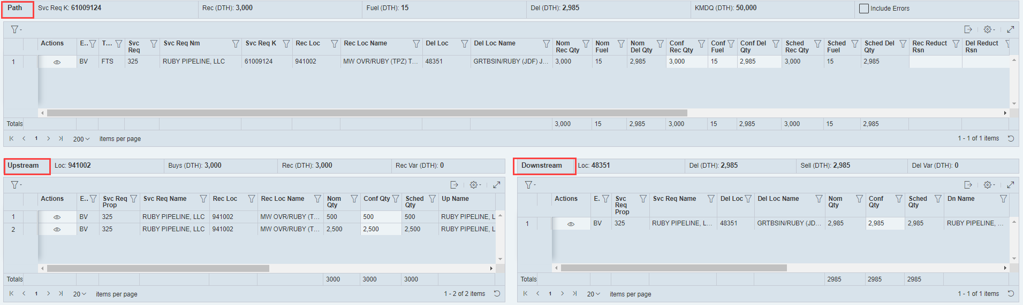
Nominations – Nom Maintenance
Path, Upstream and Downstream data
Click to Return to Index

Slide 21
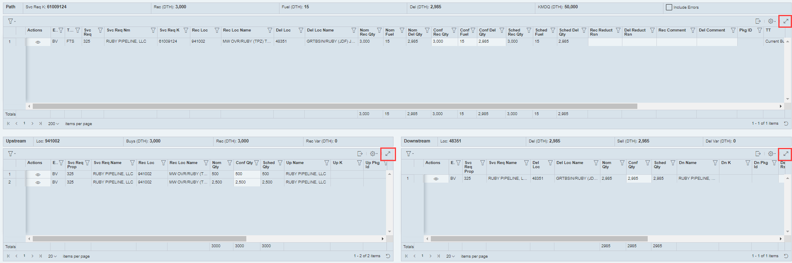
Nominations – Nom Maintenance
You are now able to adjust the size of the screens via your browser zoom feature.
You are also able to make a single section of a nom (up/downstream or path) full size by selecting the arrows in the upper right.
  Only that section of the nom will be full size.
Click to Return to Index

Slide 22
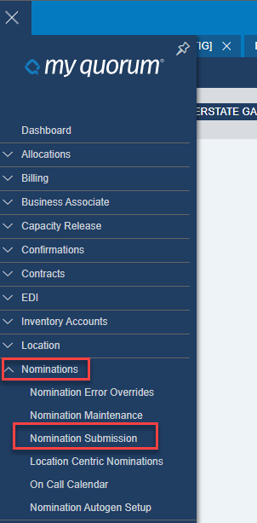
Nominations – Nom Submission
Click to Return to Index

Slide 23
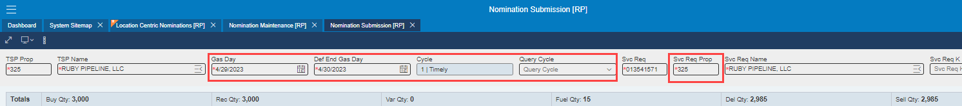
Nominations – Nom Submission
Again, very similar to classic Connect
Header information
Click to Return to Index

Slide 24
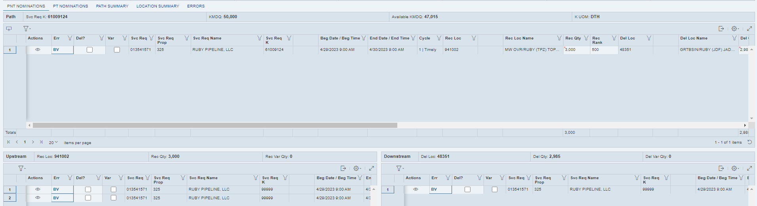
Nominations – Nom Submission
Nomination detail
Click to Return to Index

Slide 25
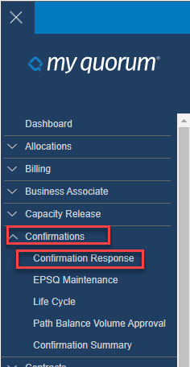
Confirmations – Confirmation Response
Click to Return to Index

Slide 26
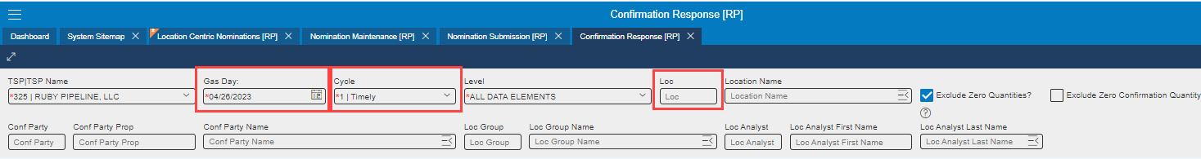
Confirmations – Confirmation Response
Similar to classic Connect
Header Entry
Click to Return to Index

Slide 27
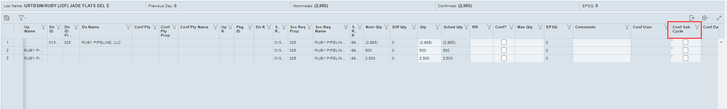
Confirmations – Confirmation Response
Location details
  You can confirm subsequent cycles but any additional reductions during cycle will be retained in future cycles so this is not recommended
Click to Return to Index

Slide 28
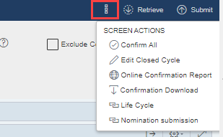
Confirmations – Confirmation Response
More Actions option allows users to confirm all, Edit Closed Cycle, etc.
Click to Return to Index

Slide 29
Tallgrass Midstream Suite PRD – eSuite Reports
System Sitemap→ eSuite→ Batch and Reporting→ Reports
Click to Return to Index

Slide 30
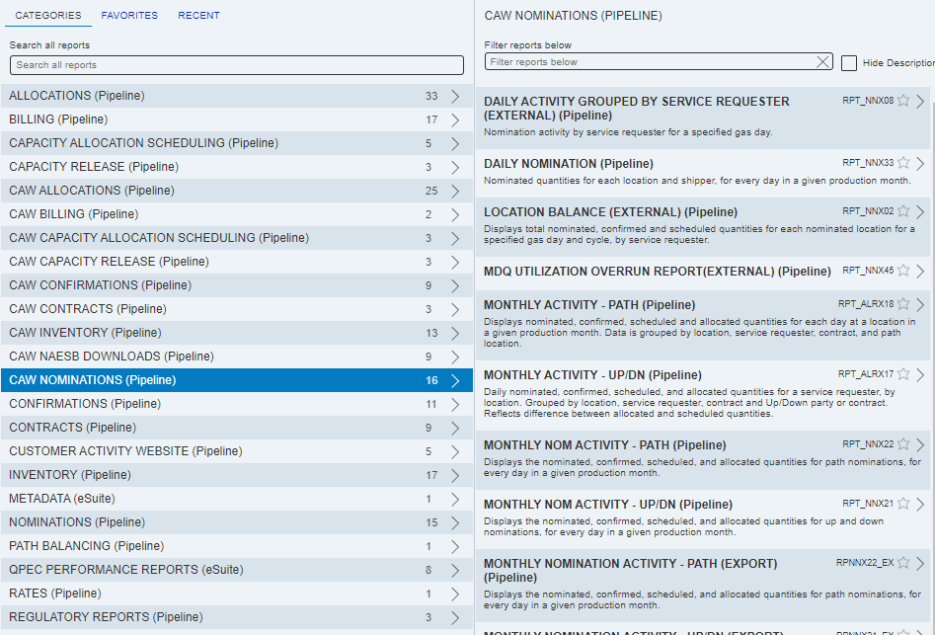
Tallgrass Midstream Suite PRD - eSuite
Nomination reports
Click to Return to Index

Slide 31
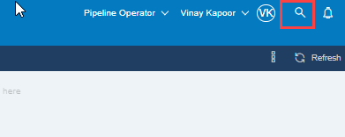
Miscellaneous
If you are not able to locate a screen, select the magnifying glass in the upper right corner of any screen and begin typing the screen name. This search feature will display all options with your entry. This only works if you know a portion of the screen name.
Click to Return to Index

Slide 32
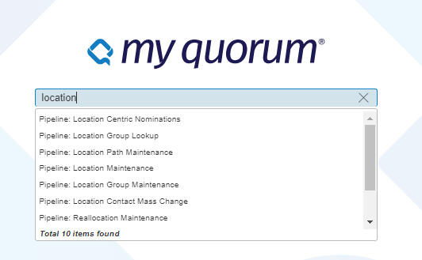
Miscellaneous
In this example, “location” was entered and all screens with the word “location” in them are displayed.
Click to Return to Index

Slide 33
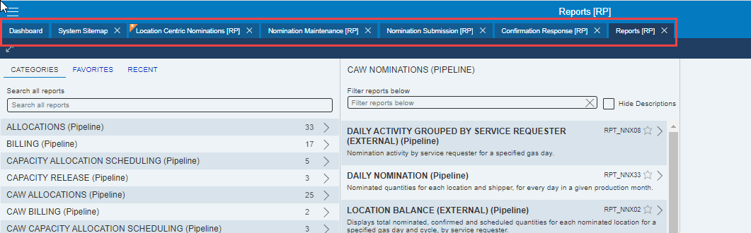
Miscellaneous
To retrieve a previously opened screen, click the desired tab located at the top of the screen.
Click to Return to Index

Slide 34
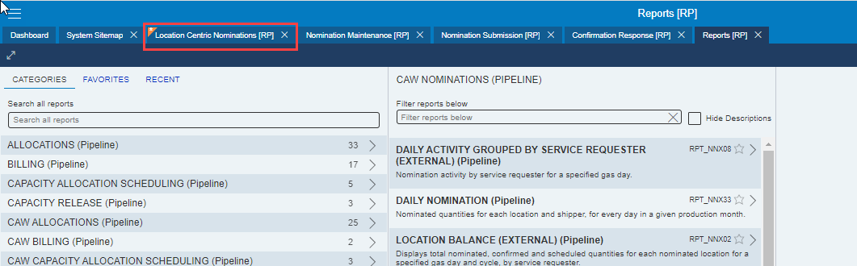
Miscellaneous
Note: the orange corner and star on “Location Centric Nominations”
  This mark indicates a tab that has been modified but changes have not been submitted
Click to Return to Index

Slide 35
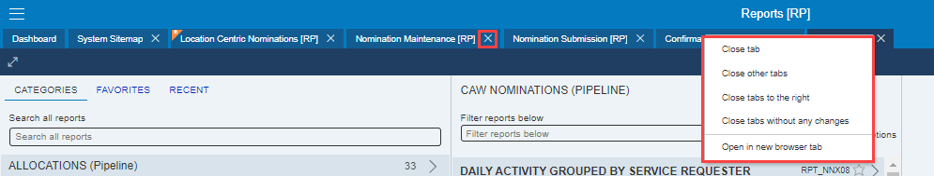
Miscellaneous
To close screens
  Select the “X” next to the tab you wish to close
  Right click and select the provided option that suites your needs
Click to Return to Index

Slide 36
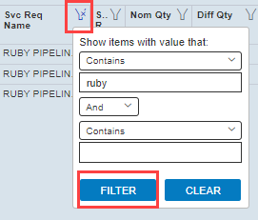
Miscellaneous
In any screen that displays the filter icon on a field, the user can select this icon to apply a filter to the entire grid of data
Enter an appropriate value in the top line, then select Filter
Click to Return to Index

Slide 37
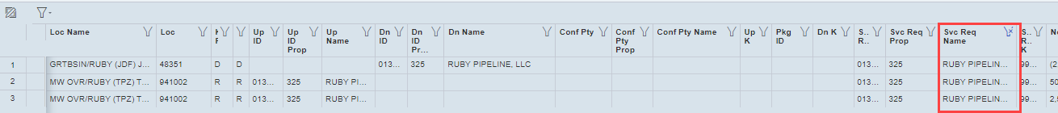
Miscellaneous
Confirmation Response where a filter has been applied on the Svc Req Name.
The filter icon has an “x” on it.
Click to Return to Index

Slide 38
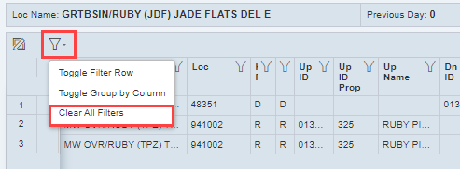
Miscellaneous
Filters will stay with grid if you change header information on the grid
To remove the filters, select the Filter box (Grid Menu), select Actions then clear filters
Click to Return to Index

Slide 39
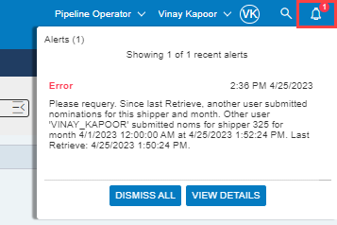
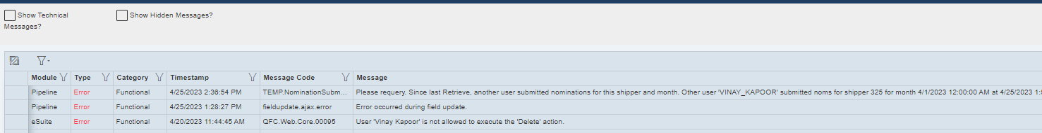
Miscellaneous - Alerts
Alerts appear in the top right hand corner
To dismiss the alert, select the ‘Dismiss All’ button
To view further information / other messages, select ‘View Details’

Slide 40
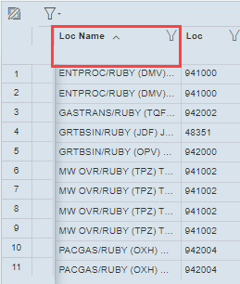
Miscellaneous
Users can sort the grid by clicking on a field once to sort in ascending order, twice for descending and a third time to remove the sort
The first sort applied to grid will have first priority so you may need to remove the first sort before applying another one
Click to Return to Index

Slide 41

Miscellaneous
Users can hide or show any column, by selecting the Gear (Grid Menu) located in the top right of the screen, then Show/Hide Columns
Click to Return to Index

Slide 42
Miscellaneous
Users can also change the sequence of fields by selecting the field and then dragging it to the desired location in the grid.
When altering the display of a grid, only have one copy of that screen open, make the modifications, then close the screen.
Next time the screen is opened, changes should be present.
Click to Return to Index

Slide 43
Miscellaneous
Being a web based system, it does not matter if you use multiple browsers. A screen in Edge will contain the same information as Chrome so you may need to open multiple copies of the same screen to display different sets of data.
Click to Return to Index

Slide 44
Miscellaneous
If you wish to open multiple instances of the application, either right click on the dashboard and open in a new tab or select your application again from the home page
Click to Return to Index

Slide 45
Miscellaneous
Contact information
Scheduling hotline – 303-763-2906
Scheduling email - TGSced@tallgrassenergylp.com
Click to Return to Index

Slide 46
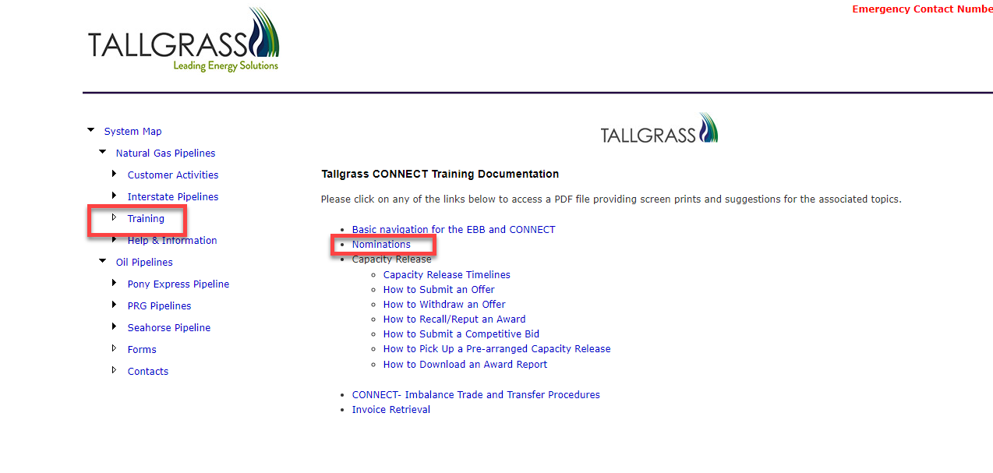
Miscellaneous
Training presentation on EBB
Click to Return to Index
Notes:
If you have any questions about needing new user access or having Ruby added to your current access, you can e mail sarah.starke@tallgrass.com. She should be able to get that sorted for you!

Slide 47
Scheduling – External Training
Questions

