Slide 1
MyQuorum – Imbalance Trades and Storage Transfers
June 2022

Slide 2
Table of Contents
Imbalance Trade Process
MyQuorum- Navigation to Imbalance Trade Form……………………….…….............................................
Completing Imbalance Trade Form (Initiating Party)...…………………………………………………………
Access Pending Trade in MyQuorum…………………………………………................................................
Approving Imbalance Trade (Confirming Party)………………………….....…..............................................
Storage Transfer Process
MyQuorum- Navigation to Storage Transfer Form ………………………….………………………………….
Completing Storage Transfer Form (Initiating Party) …………………….…………………………………….
Access Pending Transfer in CONNECT ………………………………………..............................................
Approving Storage Transfer (Confirming Party) …………………………….………………………………….
Additional Help - Contact Tallgrass ……………………………………….….……………………………….....
3
5
13
14
16
21
22
23
24

Slide 3
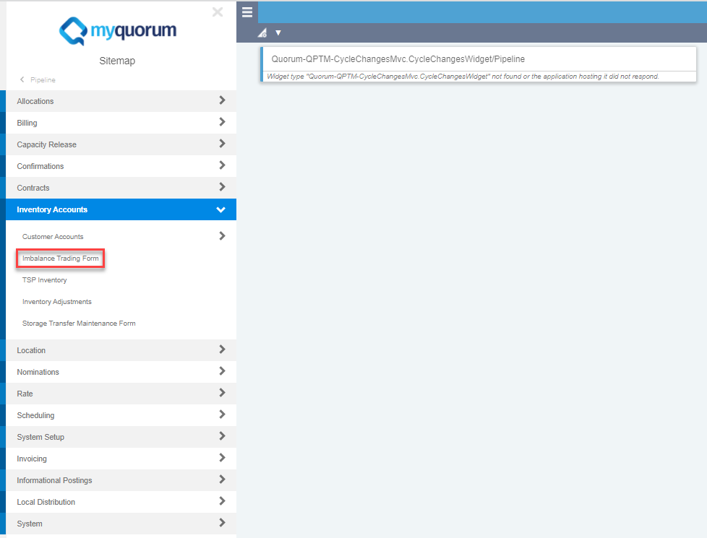
Imbalance Trade- Screen Navigation
Sitemap >> Pipeline >> Inventory Accounts >> Imbalance Trading Form
You may also use the search function and type in “Imbalance Trading Form”

Slide 4
Imbalance Trading Form
Note: Any field with an asterisk is a required field (for all screens)

Slide 5
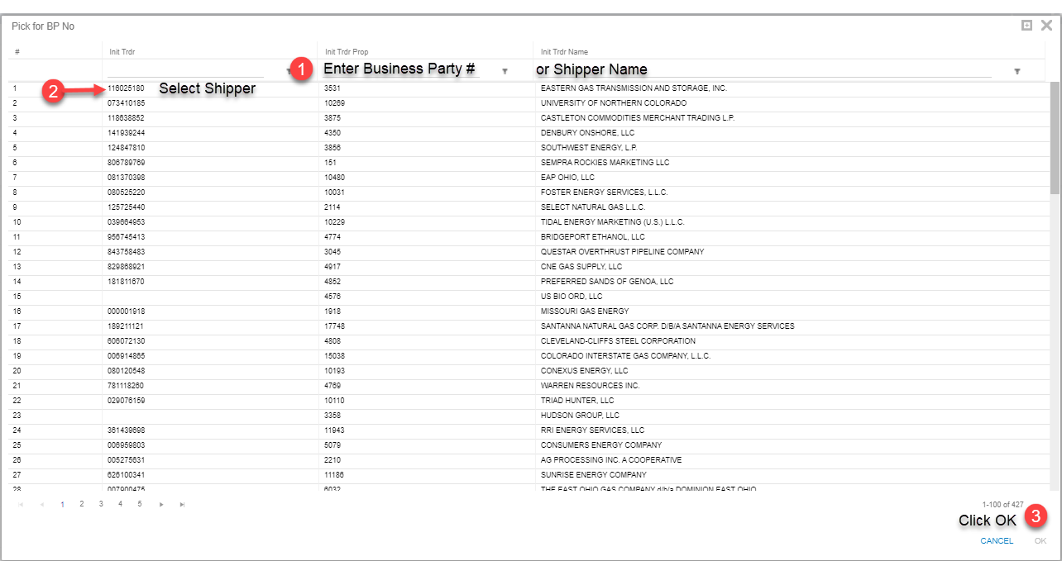
Trade Form: Enter Initiating Trader Info (Pt.1)
Click on the Pick List to Enter Shipper Data

Slide 6
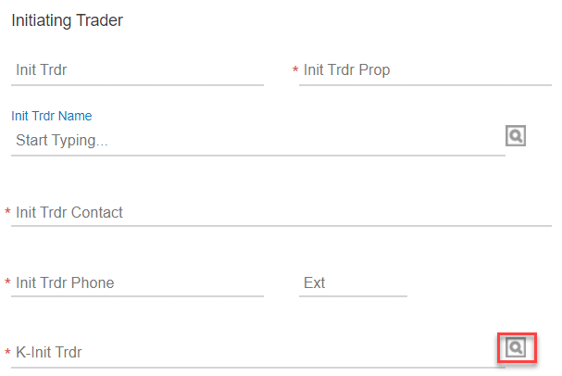
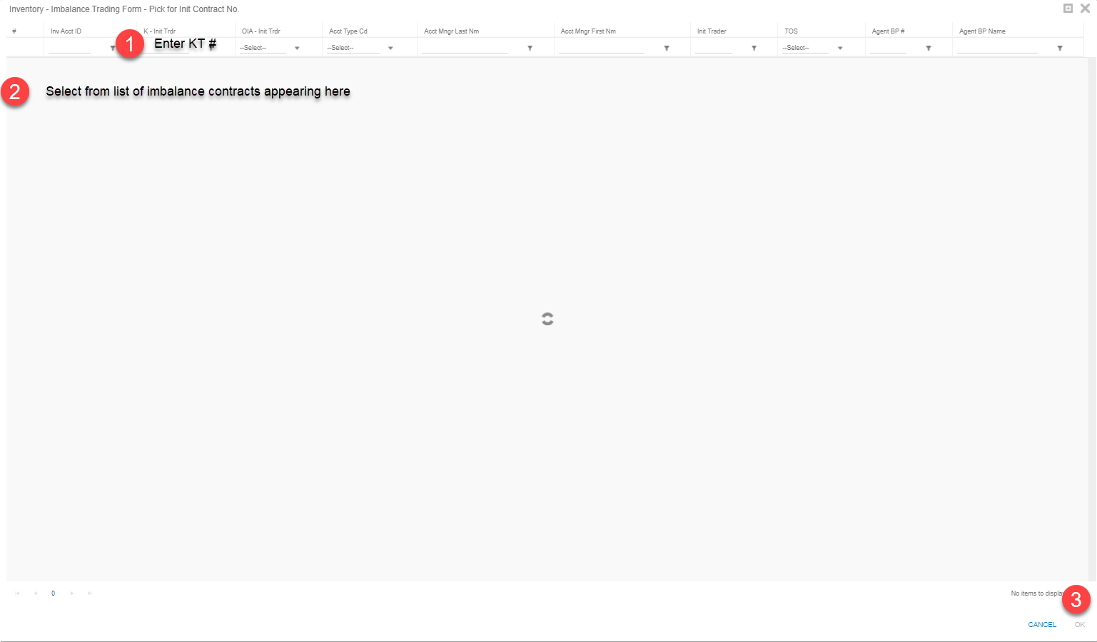
Trade Form: Enter Initiating Trader KT#
Click on Second Pick List to Enter Contract Information
(Type KT#, select KT then click “OK” to confirm selection)

Slide 7
Trade Form: Initiating Trader Info. (Pt.1)
Acct Per: Is the current open business month.
Note: on TIGT Imbalance contracts are (IMBT-BP#)
Imb Per- Init Trdr: Month Imbalance Occurred

Slide 8
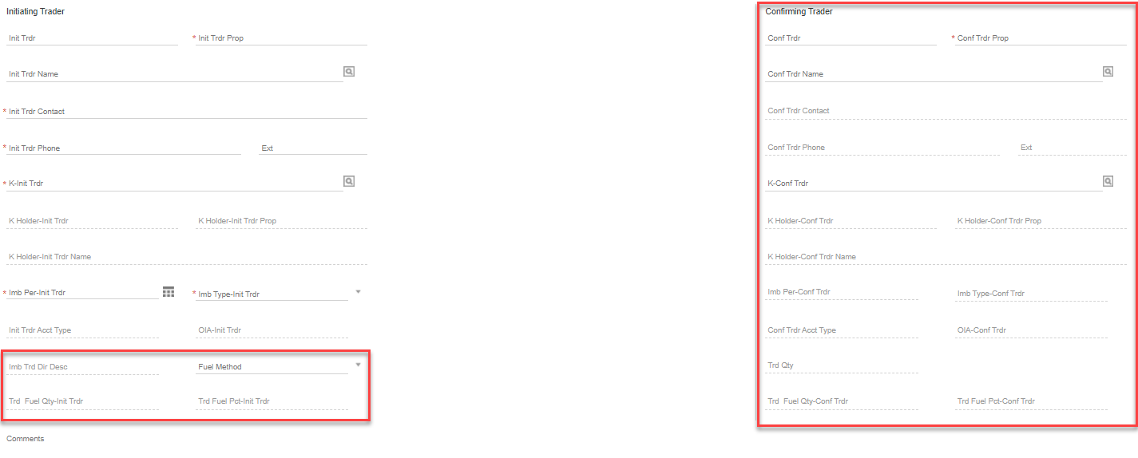
Trade Form: Selecting Trade Quantity/Fuel (Pt.2)
Fuel Method
Fuel is only deducted on injections into Storage (Long IMB)
Enter Trade Quantity
Imbalance Trade: No Fuel (leave fuel method blank)
Imbalance Trade w/ Storage: Select fuel in kind

Slide 9
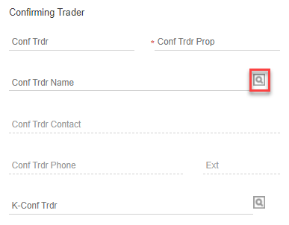
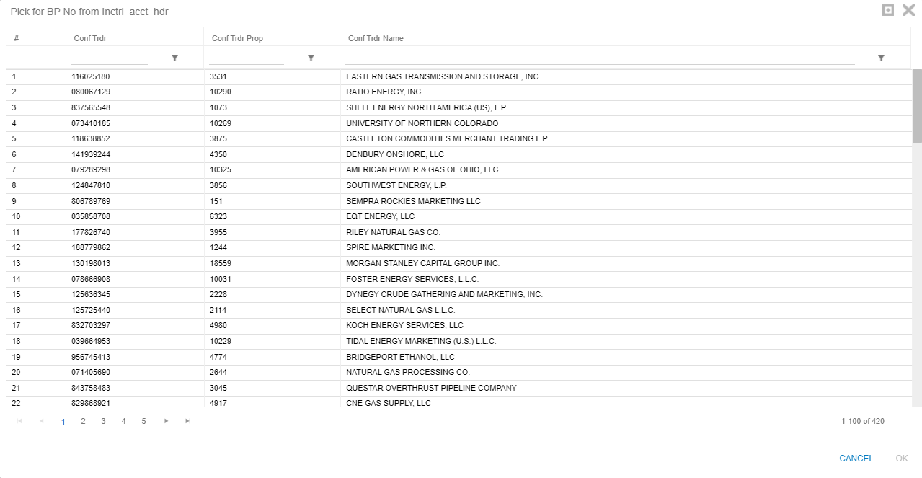
Trade Form: Enter Confirming Trader Info. (Pt.3)
Use Picklist to Search for Confirming Trader by Company Name or Business Party Number

Slide 10
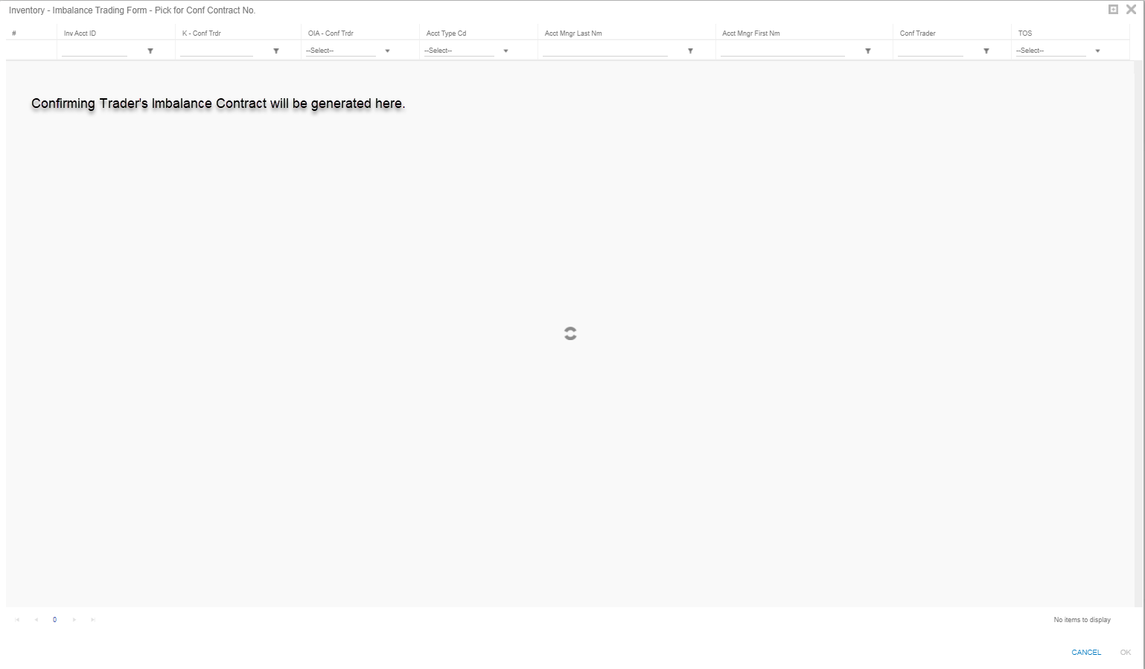
Trade Form: Entering Confirming Trader KT#
Using the second pick list, choose confirming trader’s imbalance contract.

Slide 11
Enter Confirming Trader Info. Complete
Imbalance KT#
Note: on TIGT Imbalance contracts are (IMBT-Business Party #)
Imbalance Period
Note: Imbalance period (month) must match Initiating Trader

Slide 12
Trade Form: Submitting Trade Confirmation
Once trade request has been submitted a trade ID will be assigned
Confirming Trader will use this ID to retrieve the pending trade

Slide 13
Retrieve Pending Trade for Review / Approval
Enter the trade ID# into the Imbalance Trade Form Screen and select “Retrieve”

Slide 14
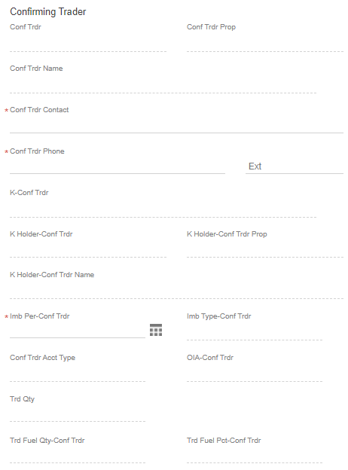
Trade Form: Confirming Trader Information
Enter contact name and phone number
Verify imbalance period and imbalance type are accurate.
04/2022
Imbalance

Slide 15
Trade Form: Confirming Trader Information (cont.)
To approve trade, click “Accept”
To deny trade, click “Reject”

Slide 16
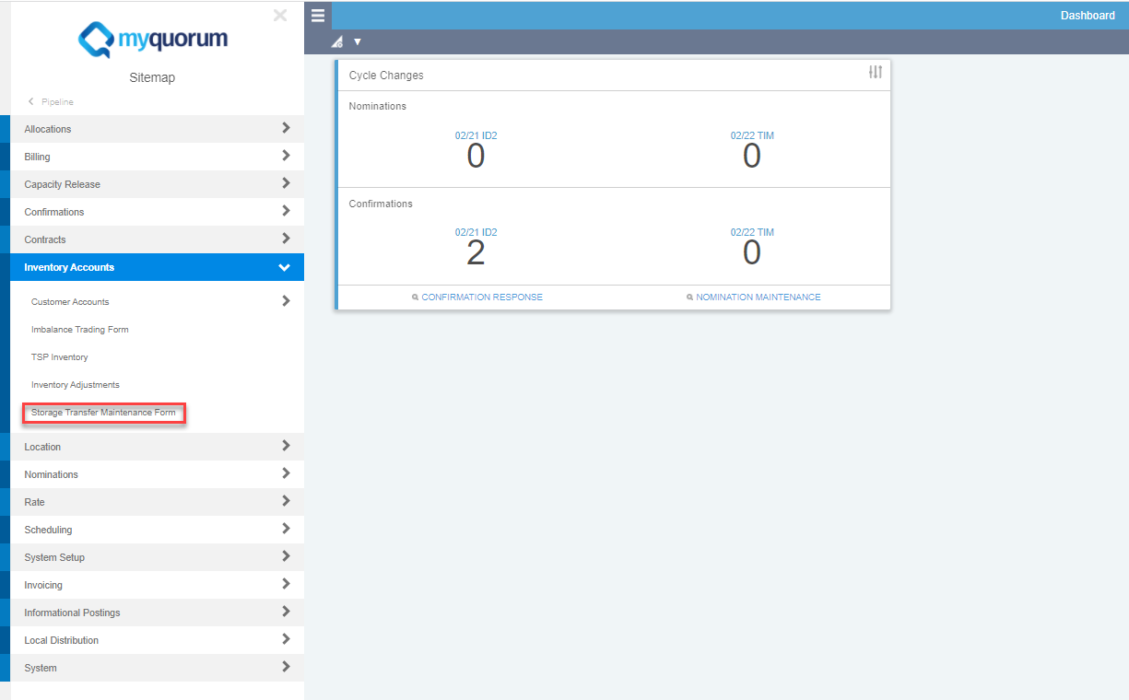
Storage Transfer – Screen Navigation
Sitemap >> Pipeline >> Inventory Accounts >> Storage Transfer Maintenance Form
You may also use the search function and type in “Storage Transfer Maintenance Form”

Slide 17
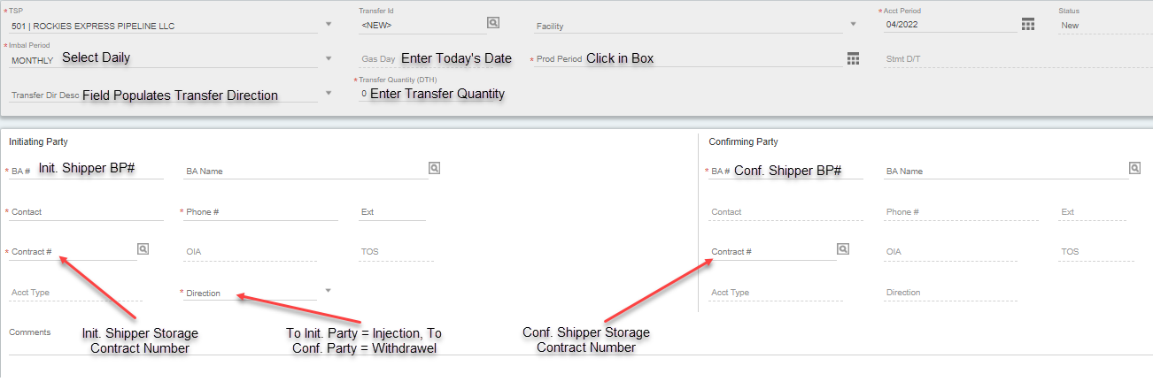
Storage Transfer Form – Initiating Party
Initiating Shipper/Trader Enters the Following Details

Slide 18
Storage Transfer Form – Initiating Party
The initiating shipper enters all storage transfer information:
Steps 1 and 2: From Monthly to Daily
A transfer is a daily process that happens in ground and is effective immediately once confirmed. Storage transfers cannot be scheduled or confirmed for a prior or future date, (Gas Day must equal Stmt D/T).
Start by changing imbalance period to daily, click in the Prod Period box below to refresh the form then enter in today’s date in the field to the right.

Slide 19
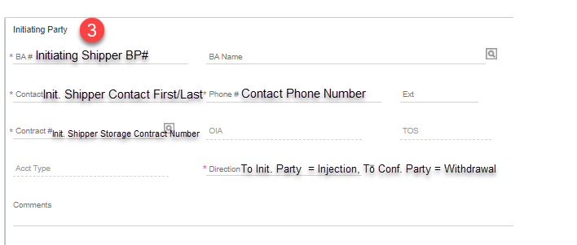
Storage Transfer Form – Initiating Party
The initiating shipper enters all storage transfer information:
3.) Initiating Party Information
Enter the Shipper BP# and hit tab to update the selection or use the picklist box next to BA Name and search for it manually.
Enter the Shipper Contact Information: (first/last Name and phone number)
Select Transfer Direction: If the initiating trader is intending to receive gas the direction is “injection” or if gas is being sent to confirming party select “withdrawal”

Slide 20
Storage Transfer Form – Initiating Party
The initiating shipper enters all storage transfer information:
4.) Transfer Quantity:
Verify Transfer Direction (reads as expected)
Enter Transfer Quantity

Slide 21
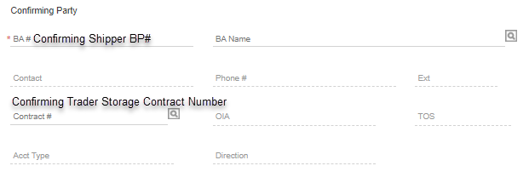
Storage Transfer Form – Initiating Party
The initiating shipper enters all storage transfer information:
5.) Confirming Party Information:
Enter confirming shipper Business Party # or use BA Name picklist
Enter storage KT# provided by confirming shipper
Once complete click “Submit Request” in the upper right-hand corner
After clicking “Submit Request” a transfer ID is created which the confirming party will use to open the transfer for confirmation

Slide 22
Retrieve Pending Storage Transfer for Approval
In the Storage Transfer Maintenance Form Screen, enter the Transfer ID # or use the picklist (magnifying glass) to search for it manually.
Transfer ID #

Slide 23
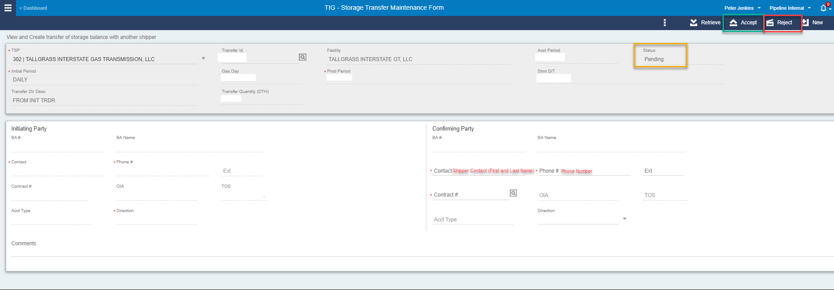
Storage Transfer Form – Confirming Party
The confirming shipper approves the transfer:
Enter Contact Information: first/last name and contact number
Review the Transfer Info and Accept if approved or Reject to cancel
Communicate Record Status with initiating party
Please Note: Transfers are only valid if they are submitted and verified in the same day. Whereas Gas Day = Stmt D/T. This is a timely process that cannot be verified retroactively or for a future gas day.

