Slide 1
External Capacity Release

Slide 2
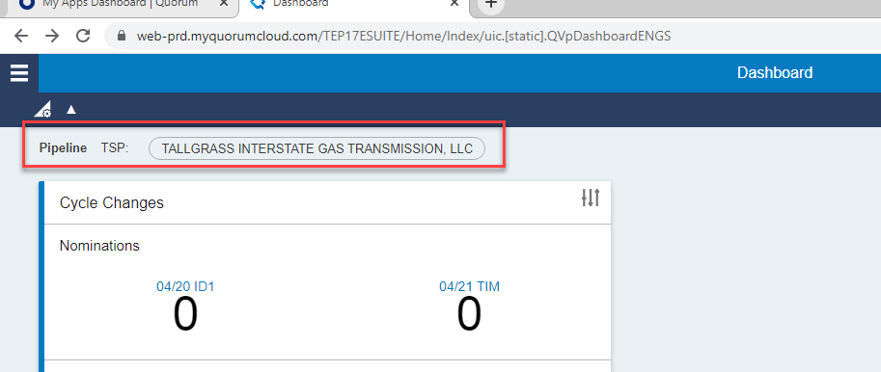
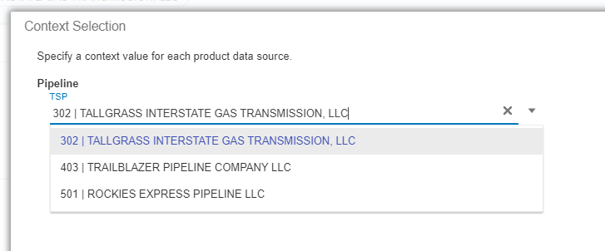
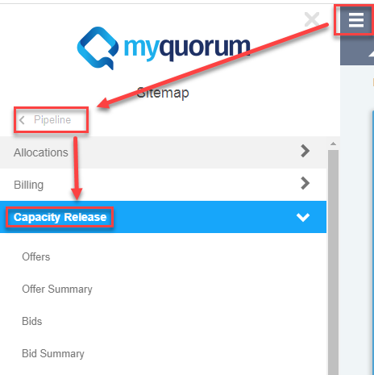
Capacity Release
When you open Connect you start at the Dashboard and choose your TSP, click on the TSP name, choose from the drop-down Query and click Update
Then in the upper left corner choose the drop-down menu.
Which will give you the option to choose Pipeline
And the navigation tree will appear, and you can choose Capacity Release.

Slide 3
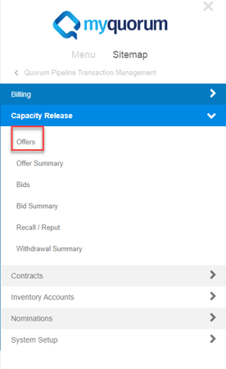
System
Capacity Release
Offers
Offer Summary
Bids
Bid Summary
Recall/Reput
Withdrawal Summary

Slide 4
Capacity Release
Capacity Release: The process through which Business Associates with Firm capacity on the pipeline (FT, FTS, FTSX, FSS, NNS, SCS, or CMC-2) can release either temporarily or permanently, all or a portion of their capacity, to another Business Associate. For temporary releases, while the system will generate a contract and K#, the contract is not between Tallgrass’ TSP, but between the two Business Associates, Tallgrass is merely facilitating this contract in our system for Scheduling purposes. Permanent capacity releases become between Tallgrass’ TSP and the Replacement Business Associate, and a document will be generated, and the contract will be reported going forward on the Index of Customers.
Note: all replacement shippers are required to have a Master Capacity Release (UMB) in place for each TSP.
Offer: the process starts when a Business Associate submits an Offer on the system.

Slide 5
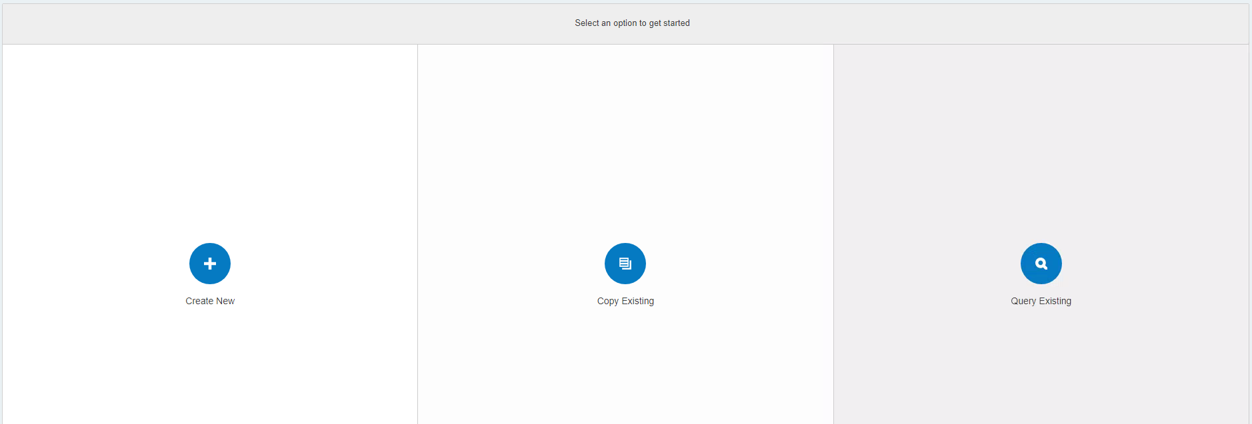
Offer
After opening Offers a Business Associate will have 3 options: Create New, Copy Existing or Query Existing.

Slide 6
Offer
Create a New Offer

Slide 7
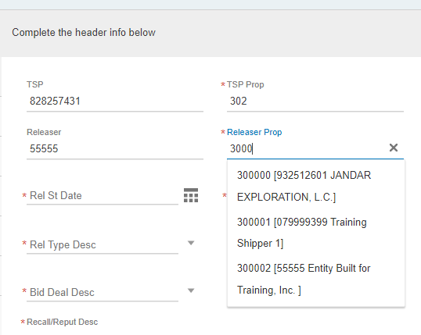
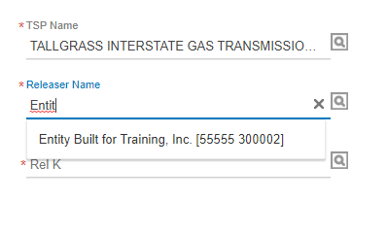
Offer
First update the Header fields
Begin by updating the Releaser Prop (BA ID #) or Releaser Name (type it in or use the pick list (magnifying glass icon)) and this will fill in the releaser’s information in the field you do not start with.

Slide 8
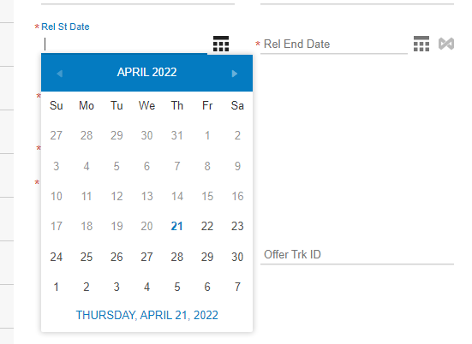
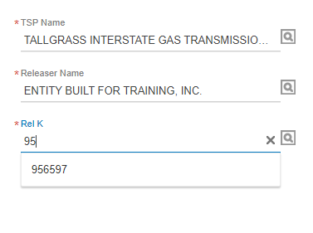
Offer
Next add the Release Start Date and Release End Date. You can either type it in or use the drop-down calendar.
Then add the K# being released by either typing in the number and a drop down of potential K#s will appear or you can utilize the pick list (by clicking on the magnifying class icon).

Slide 9
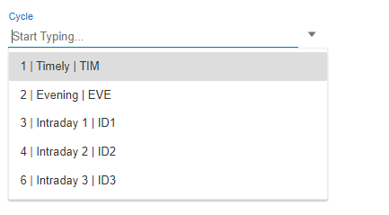
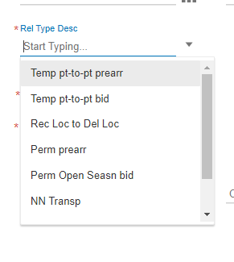
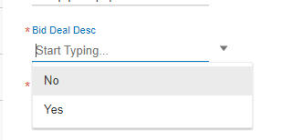
Offer
Then choose the Cycle for which you wish the replacement K# to start. This is needed for intraday non-biddable temporary releases. Otherwise, the field is optional, or you can go with the standard Timely.
Then choose the type of Release
Note: if you choose to do a
Permanent Capacity Release
please contact TG first. There are
several pre-approvals required
before you build the offer.
Then whether or not the Release is going to be
biddable or non-biddable.

Slide 10
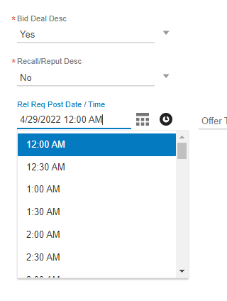
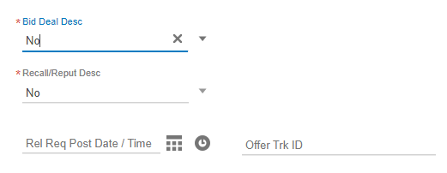
Offer
If you choose Non-biddable you will not have to populate the posting time
If you do a biddable deal, use the Calendar and Clock icons to populate the
the date and time you want it to post. Remember post time needs to be prior to an Open Season
bid window, to allow replacement shippers to review the offer.

Slide 11
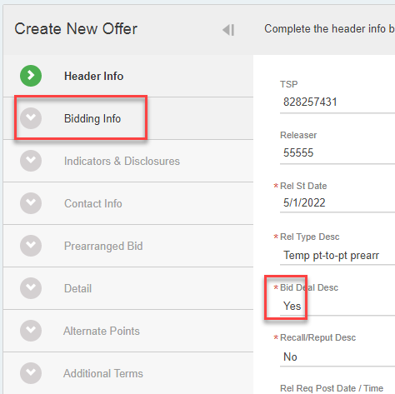
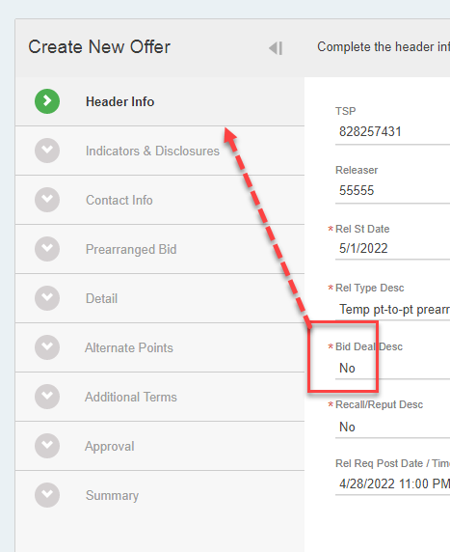
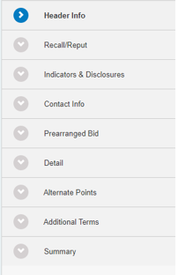
Offer
If you choose to do a biddable offer a new tab will appear for Bidding Info, but if you choose a non-biddable deal you will move directly to Indicators & Disclosures

Slide 12
Offer
If you choose a biddable deal you must fill in the open season dates and times by clicking on the calendar and clock icons.

Slide 13
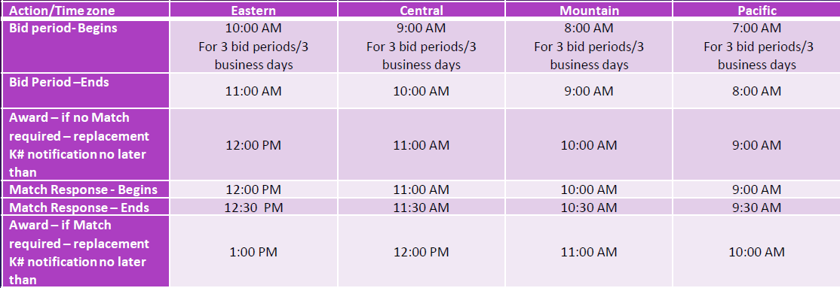
Offer
Capacity Release time lines

Slide 14
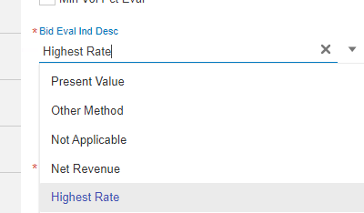
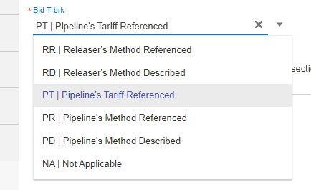
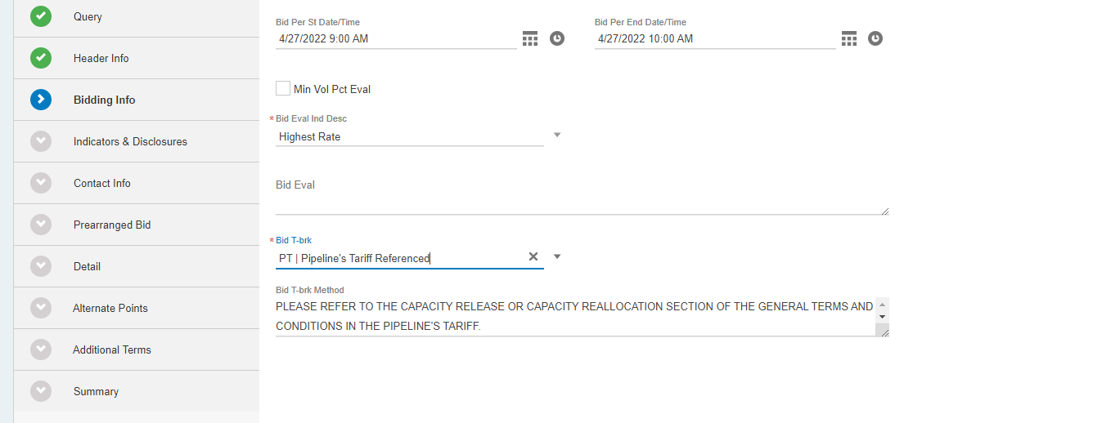
Offer
Also, if you choose to do a biddable deal you will have to pick your preferred Bid Eval Ind Desc and your preferred Bid T-break method

Slide 15
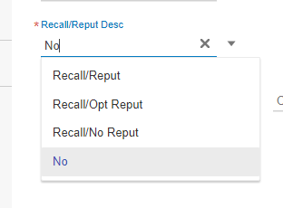
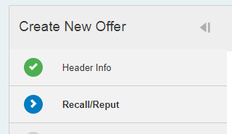
Offer
Final drop down on the Header Info tab is Recall/Reput Desc. There are multiple options on the drop down.
If you choose anything but No, a Recall/Reput tab will appear
First, choose if you want the Replacement Shipper to receive a Notification on a Business Day or not. Note: if you choose that they cannot receive a Recall notification on a business day, then you cannot choose to recall on a non-business day because the Replacement Shipper must receive a notification prior to the Recall happening.

Slide 16
Offer
Using the drop-down menu, you can denote which time cycles the notifications can go out. Reminder you can only recall for a cycle if you have picked that cycle for a notification to go out.
Recall must be in the system prior to the time listed below for each cycle.

Slide 17
Offer
Final section to fill out is Recall/Reput Terms Type
If you choose Default Terms Text, you are done with this tab
If you choose Releaser Required Text, you will have to fill out the line below

Slide 18
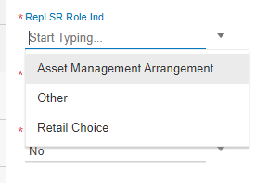
Offer
The next section is Indicators & Disclosures
The first drop down is to indicate whether or not the capacity can be re-released to another capacity release as a grandchild contract.
Then you can choose Replacement Shipper Role Indicator. Note: if you choose
Other and are trying to do a non-biddable release, the FERC rules on back to
back releases apply.

Slide 19
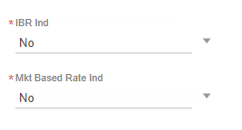
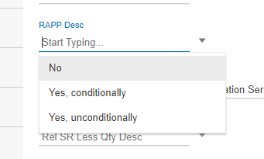
Offer
The next two Yes/No drop-down menus are for Index Based Rates Indicator and Market Based Rate Indicator; these indicate if the Capacity Release is utilizing an Index or Market Based Rate or not.
RAPP or Right to Amend Primary Point indicator. Note: if you choose Yes and the Replacement Shipper changes your Primary Points there is no guarantee you will get them back at the end of a temporary release.

Slide 20
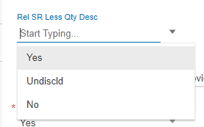
Offer
Disclosure Description: Where you can choose what conditions of the offer potential Bidders can see.
Release Shipper Less Quantity Description to indicate whether
you will accept a bid for less than the full quantity offered.
Minimum Rate Disclosure Description
Then you can choose if you want to disclose the minimum rate you are willing rate to accept.

Slide 21
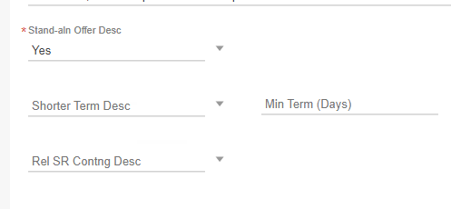
Offer
The final section of this screen starts with Stand Alone Offer Description. Is this offer tied another offer?
Are you willing to accept a shorter term, if yes Then enter the number of days you will accept.
If no, you can leave Min Term (Days) blank.
Finally indicate if this Offer is contingent from the Bidder’s point of view.

Slide 22
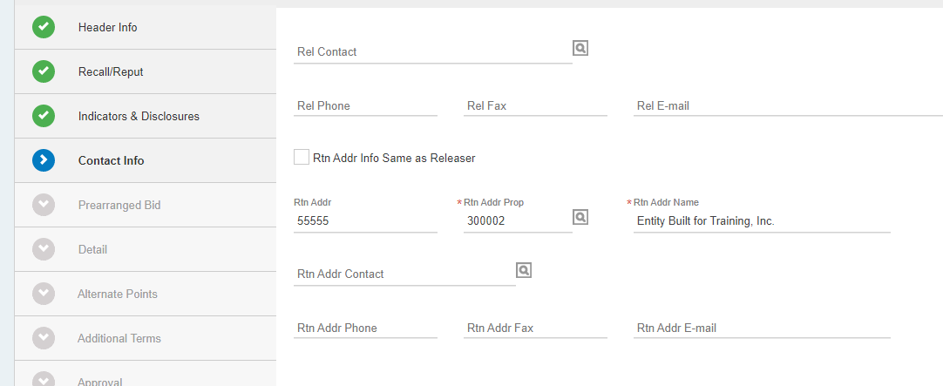
Offer
Contact Info tab is where the Releasing Shipper puts the info for the party to receive System Email Notifications. Also, TG employees will use the party listed here to reach out if there are questions about the offer.

Slide 23
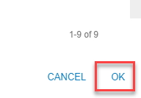
Offer
You must choose a party already in the system. You can click on the magnifying glass icon to query
From the query screen you can highlight the appropriate user and click OK in the bottom right corner

Slide 24
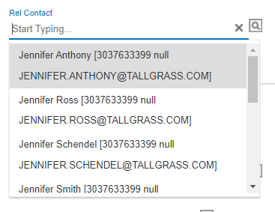
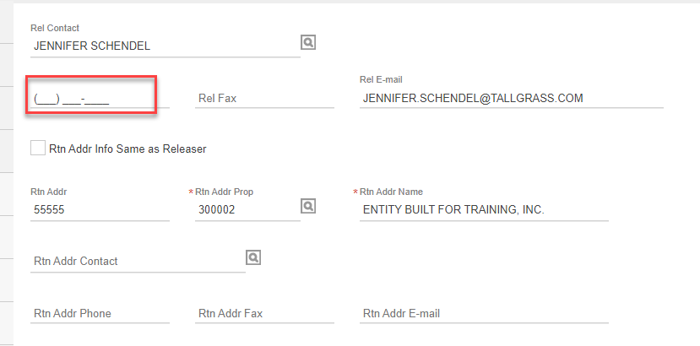
Offer
Or you can start typing and get a drop-down menu of users
This will populate the user and their email and the Return Address Name, so if you want other information, like a phone number, you will have to populate this information yourself.

Slide 25
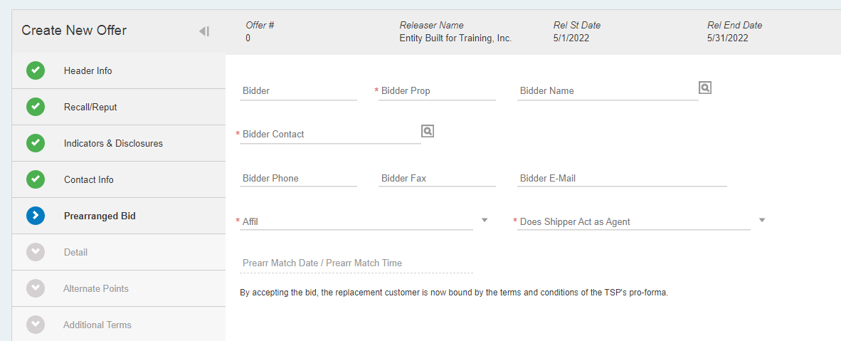
Offer
If you have a Pre-Arranged Bidder, the next tab will be for indicating who they are, and which party should receive Email Notifications tied to the Offer.

Slide 26
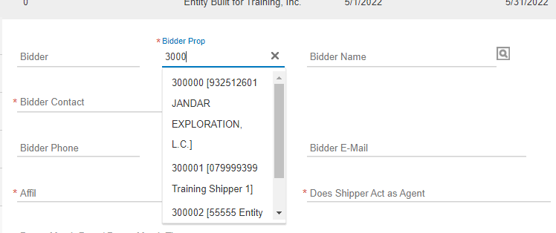
Offer
Either start typing in the Bidder Prop (Business Associate ID #) or Bidder Name. Or use the Query to pick your Pre-Arranged Bidder.
After adding the Pre-Arranged Bidder, either use the Query
or start typing and pick the contact you want to receive
Notifications.

Slide 27
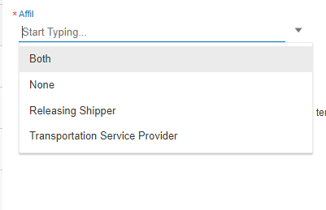
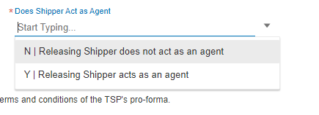
Offer
Then add if the Pre-Arranged Bidder is an Affiliate of the Releasing shipper or the TSP. Next, idintify if the Releasing Shipper is an agent
Finally, the Prearr Match Date/Prearr Match Time is left blank and is un-populatable

Slide 28
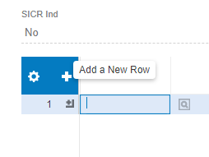
Offer
On the Detail tab, start by adding a row. It is one row per path (Receipt/Delivery Location pair). Add the row by clicking on the plus icon.
Then click on the magnifying glass icon to get the Releasing Contract info
This will show in the query screen all of the potential Contracts for release and the path(s) available, MDQ on each path, Type of Service, and Route. Highlight the K# and path you wish to release and hit OK at the bottom right corner of the screen. Repeat these steps as many times as needed.

Slide 29
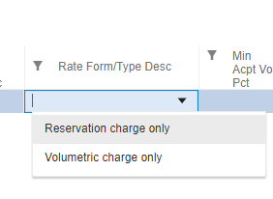
Offer
The next box you fill out in the Detail tab is Max Offer Qty-Loc: the amount of capacity in dekatherms you want to release.
Then choose the Rate Form/Type Desc from the drop-down menu.
Reservation Charge Only means the Replacement Shipper will be invoiced for the
full MDQ on the release whether they flow it or not.
If you choose Volumetric Charge Only, you must denote the minimum value a Replacement Shipper
will be charged regardless of how much gas they flow.
Only populate either Min Acpt Vol Pct or
Min Acpt Vol Qty.

Slide 30
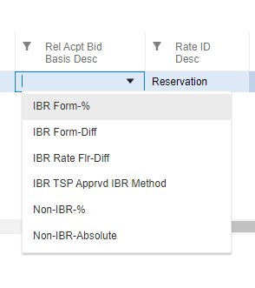
Offer
The Rel Acpt Bid Basis Desc is the bid basis acceptable to the releasing shipper; choose from the following drop-down menu
I Index Based Rate Formula – Percentage
Index Based Formula Differential – Dollars and Cents
Index Based Rate Floor Differential - Dollars and Cents
Index Based Rate TSP Approved Index Based Rate Method
Non-Index Based Rate percentage of maximum tariff
Non-Index Based Rate absolute dollars and cents

Slide 31
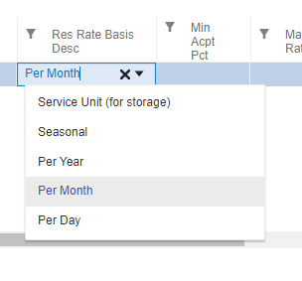
Offer
If you choose Reservation, the next drop box to use is Res Rate Basis Desc and it defaults to Per Month (if you are using a different basis, especially Per Day, verify your drop-down choice before submitting the offer, or you could end up with a bid far below what was intended).

Slide 32
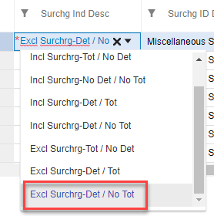
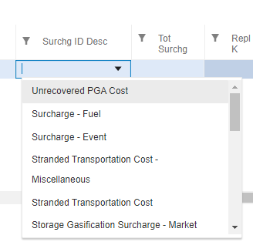
Offer
Even though it is white, indicating you can update the column, you will find Surcharge Indicator Description is pre-populated with Excl Surchrg-Det/No Tot, meaning that you are excluding the surcharge detail and no total charged. Even if you are not including a surcharge you will need to fill out the next column.
A major change from the current system is that
Surcharg ID Desc is now a required field. If you are
copying forward from an existing offer in the old
System, YOU HAVE TO POPULATE THIS FIELD.
if not the offer will error out. After the first offer
copied forward in the upgraded system it should
already in the system going forward.

Slide 33
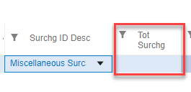
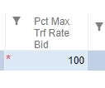
Offer
You can populate the Tot Surchg or leave it blank.
If you chose Non-IBR % for your Rate Basis your final If you chose Non-IBR Absolute for your Rate Basis your final
field to fill out is Pct Max Trf Rate Bid, use 1 – 100 field is to fill out Rate Bid. Note: this number cannot exceed the TSP max tariff on deals greater than
1 year.
The next tab in the system is Alternate Points – TG does not use this tab at this time, just click Next in the bottom right corner.

Slide 34
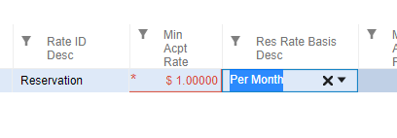
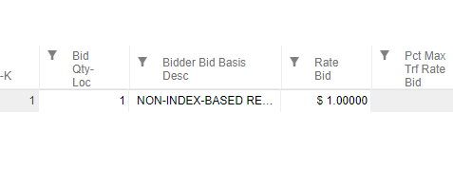
Offer
If you’re doing a biddable deal you have to put in the Min Acpt Rate this will populate the Rate Bid field for the pre-arranged bid.

Slide 35
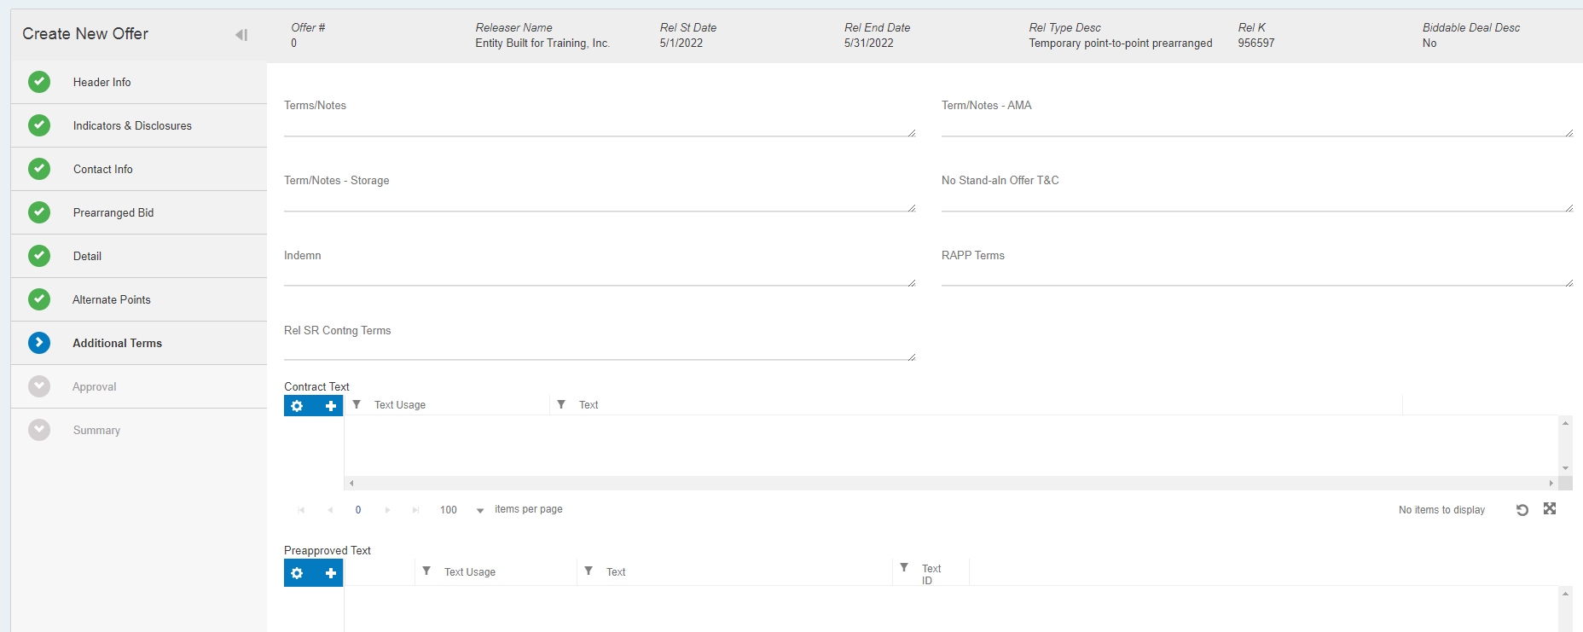
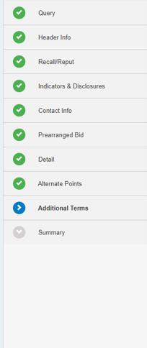
Offer
Additional Terms – please add terms and notes if needed. If you are releasing rights from a DRA/NRA, this is where you will specify what rates or secondary points are being released as part of the offer. If nothing is specified here, per the DRA/NRA, the replacement shipper will be charged per the tariff. This field is required for AMA releases.

Slide 36
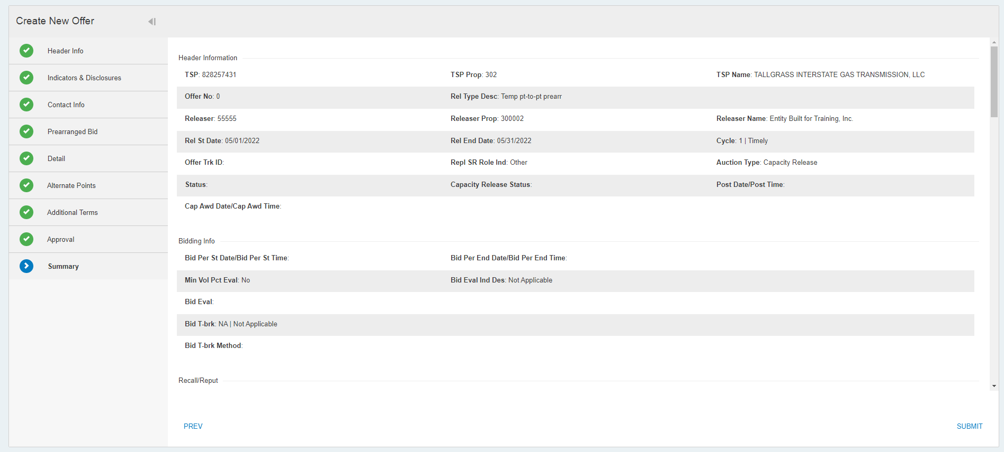
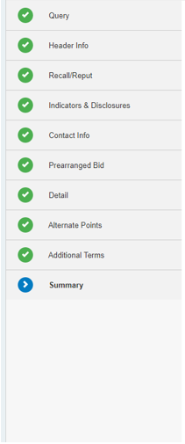
Offer
The Final Tab on an offer is Summary, and it summarizes the entire offer. Review and hit Submit in the bottom right Corner.

Slide 37
Offer
After you hit submit you will see your Offer Number.

Slide 38
Offer
If you want to copy forward an Existing Offer, choose Copy Existing from the first screen under Offer.

Slide 39
Offer
There will be a Query tab that will show the Offers you can copy. You will see Awarded/Approved Offers from other Releasing Shippers. These are visible as all Offers are public at this status point.
You will only be able to copy forward your own Offers.

Slide 40
Offer
Once you highlight the Offer you wish to Copy you will see the tabs along the left side that are the parts of the of the Capacity Release. If you do not see these tabs, then the system has not recognized that you have chosen an Offer to copy. Click Next in the bottom right corner when ready to copy.

Slide 41
Offer
When the Header Info tab opens, you will note there are no action buttons in the upper right corner. Do NOT change anything here, yet. If you do make a single change and hit Next the Detail tab you are wishing to copy in this Offer, will be erased by the system. To prevent this, at this time we have created a work around, so just hit Next.

Slide 42
Offer
Once you have hit Next to Recall/Reput tab, if
as in this case your offer is recallable or the
Bidding Info tab if your offer is biddable, you
will now see that your Offer # is 0 and there
are action buttons in the upper right corner.
Hit Save now.

Slide 43
Offer
You will know the offer has saved because a number greater than 0 will now appear under Offer #. Note this number down.
Then hit the X in the upper right corner and close this screen.

Slide 44
Offer
You are going to back into the Offers screen from the beginning.

Slide 45
Offer
This time instead of choosing Copy Existing, choose Query Existing.

Slide 46
Offer
In this screen you should see the Offer # you just created in the Copy Existing screens.

Slide 47
Offer
Again you highlight the Offer you wish to Copy you will see the tabs along the left side that are the parts of the of the Capacity Release. If you do not see these tabs, then the system has not recognized that you have chosen an Offer to copy. Click Next in the bottom right corner when ready to copy.

Slide 48
Offer
Now you can make changes on the Header Info tab. Then hit Next after you have changed the fields you wish.

Slide 49
Offer
This way when you get to the Detail tab, there is information.
Until the Offer is Saved you will see a blank header.

Slide 50
Offer
If this is blank, you have not followed the work around explained starting on page 37.

Slide 51
Offer
If you wish to Delete or Duplicate a path, hover over the line number and you will see a pop up and click the action you wish to take.
If you choose to Delete a path you will a see a dot with x icon on that line and if you hover over it, the system will let you know that path will be deleted once you hit Save.

Slide 52
Offer
Once complete all tabs will be green, review
your Summary tab. When you agree with data
hit Validate in the upper right corner or Submit
(located at both the top and bottom of the screen).
Hit Save if you want to save the offer and come
back later before you hit Submit.

Slide 53
Offer
You get a green dot when the offer has been successfully Submitted.
If there are errors, you will see an error message in your upper right corner and the tab with the error will be denoted in red. If you are not comfortable solving the Error yourself
Please reach out to the Contracts team at the hotline # 303-763-3399. Please screen shot the error and the tab that is read. If you can save the offer, without submitting please do so.

Slide 54
Offer – How to Withdraw
As long as an Offer is in Approved status and not been Bid upon, it can be Withdrawn.
Start buy going to Query Existing under the Offers menu.
Look for the Offer
in Approved status you
wish to Withdraw.
.

Slide 55
Offer – How to Withdraw
When you highlight that line, a Withdrawal tab will appear on the left of your screen.
Click on Next at the bottom right to open screen.
Watch out when the screen opens that it will jump from Query to Summary, so you will have to click on
on Withdrawal to update the tab.
.

Slide 56
Offer – How to Withdraw
First update the GID/BA Entity ID#/WID Co Prop number, so the system confirms the Releasing Shipper is the Withdrawing party.
Then add under Comments the reason for
Withdrawing the Offer and then hit Withdraw.
.

Slide 57
Offer – How to Withdraw
The screen will show that your offer has been Withdrawn with a green dot.
You can confirm by opening the Query Existing again and checking the Offer Status.
.
.

Slide 58
Offer Summary
The Offer Summary screen is where you can see all existing offers on the TSP.
You can pick to filter the offers down by a selection of descriptors
Then hit Retrieve in the upper right corner

Slide 59
Offer Summary
After you retrieve for the filter, you can highlight a specific offer and read the detail screen in the drop down below.

Slide 60
Bids
Once you receive an Offer, or if you want to see if there is competitive Offer to bid on, open Bids.

Slide 61
Bids
The most common type of Bid is accepting Pre-arranged, to accept a Pre-arranged bid, click on Find and Submit a Prearranged Bid.
Once the Query opens, highlight the Offer you’re going to bid on.
Then hit Next in the bottom right corner.

Slide 62
Bids
Then review all the tabs on the bid, to make sure the offer is what was expected.

Slide 63
Bids
As you review the bid screens you will note that after reviewing the Additional Terms tab you will need to click a box confirming you have reviewed the Prearranged bid and all of the terms and notes. If you do not click this button, you will not be able to submit the bid.

Slide 64
Bids
After you review the Summary tab, Validate and Submit.

Slide 65
Bids
Then you will get a notice if your bid has been successfully submitted.

Slide 66
Bids
How to submit a competing bid for a biddable deal. Click on Create a New Bid.

Slide 67
Bids
Enter the Offer No. you wish to bid on or you can use the pick list (magnifying glass icon) to choose from multiple offers which one you wish to bid on.

Slide 68
Bids
Once you have populated the Offer No you wish to bid on, review the release term dates and enter the Bidder details.
Then add your BA Entity ID number under
Bidder Prop. This is because even though you are
logged in, Users may act on behalf of more than one
Business Associate so the system requires verification
of which entity they’re acting on behalf of.

Slide 69
Bids
After Bidder Prop is entered, the Header Info is complete, you hit Next in the bottom right corner and move to the Indicators tab.

Slide 70
Bids
Update the Bid with Bidder Less Qty Dec if you will accept less than the full amount or not.
If you are an Affiliate of either the Releasing Shipper, the TSP or neither.
Finally, is this a Stand-Alone bid.

Slide 71
Bids
Once you have completed all the Indicators hit Next in the bottom right screen.

Slide 72
Bids
In the Contact tab, add the contact for the TSP to notify via email if they are awarded the Replacement Contract.

Slide 73
Bids
Review the Details tab by scrolling right. Review: Receipt/Delivery locations, MDQ, Rate Description.
If you are putting in a Competitive Bid for a pre-arranged Offer, you will see a minimum rate here.
Update the amount to the bid amount you wish it to be and tab off.

Slide 74
Bids
Next is the Alternate Points tab. At this point Tallgrass does not utilize this tab.

Slide 75
Bids
On the Additional Terms Tab review the terms and click on the box to confirm you have read them.

Slide 76
Bids
Final tab is a Summary of the bid, please review, then hit Validate and Submit in the upper right corner.

Slide 77
Bids
When your Bid is successful you will see a green dot with Bid number.

Slide 78
Bid Summary
You will only be able to see the Bidder on your own bid, but you can see the details of other bidders, but not who they are.
If you do not see your bid, it was not submitted successfully. If you are the pre-arranged bidder and Bid Rec Date/Bid Rec Time is blank, the bid was not submitted successfully.
You are also looking for Approved under Capacity Release Status.
If you have no issues, you can leave the screens and wait for an award notification email.

Slide 79
Bid Summary
If you decide you want to Withdraw your bid and it has not been awarded (e.g. you notice something is wrong or your change your mind) highlight the line and hit Next in the bottom right corning a Withdrawal tab will appear.
Add the reason you’re withdrawing the offer and click Withdraw in the upper right corner.

Slide 80
Bid Summary
When it’s it is Withdrawn, you will see a green dot saying the Bid # has been Withdrawn.

Slide 81
Bids
If on the Bid Summary you see a higher bid, and you are the pre-arranged shipper, go back to the Bids screen and choose Copy a Prearranged Bid for Match Period

Slide 82
Bids
Re-open the offer and your bid. Click through the tabs until you reach the Details tab.
Scroll right to the rate bid Change the rate to match the Competing Bid and tab off
Complete by hitting next until the summary page, review and hit Validate and Submit.

Slide 83
Recall/Reput
If you need to Recall capacity, go to the Recall/Reput screen.

Slide 84
Recall/Reput
Add the Replacement K# number under Replacement SR K# or use the pick list and hit Retrieve.
If the Replacement Contract has more than one path, then you will see multiple lines.

Slide 85
Recall/Reput
Hover over the line containing the path (R/D pair) you wish to recall capacity on and right click until you see Recall.
Then you will see a line populate below denoting the action for the path/MDQ is Recalled.

Slide 86
Recall/Reput
Update the Rel Start Date for when you want the Recall to begin and the
Rel End Date for when you wish it to end.
Update the Qty-Loc to amount of MDQ you wish to Recall.
Finally update the Recall Notif Period for when you wish to the Replacement
Shipper to receive notification that the gas is being recalled. Please refer to your offer, if you are unsure what Recall notification periods you allowed for. If the system does not allow for Recalls on a non-business day or for Early Evening, then those options were not made available on the offer.
After updating the line, hit Submit in the upper right corner of the page.
The path will have returned to the top half of the screen and now show as Recalled.

Slide 87
Recall/Reput
To reput hover your mouse over the Recalled path you wish to Reput and right click on your mouse. The word Reput appears. Click on the pop-up button.
If you change your mind and want to delete the Reput (or a Recall) if you have not hit Submit hover over the
Capacity Release Status and right click until the Delete button appears and click on it. This will remove the line and
leave the capacity status as it was originally.
If you wish to proceed again, update the Rel Start Date for when you want the Reput to begin and the
Rel End Date for when you wish it to end. Note: Recall and Reputs cannot occur on the same gas day.
Update the Qty-Loc to amount of MDQ you wish to Reput.
Finally update the Reput Notif Period for when you wish to the Replacement Shipper to receive notification that the gas is being reput.
Then click on Submit.

Slide 88
Recall/Reput
The capacity will now show as Reput.
Reminder all Recalls must be submitted to the TSP prior to the below times:
Reputs must be submitted to the TSP prior to this time:

Slide 89
Withdrawal Summary
This screen will show the history of all Offers and Bids that have been Withdrawn on the TSP.

Slide 90
Contact
If you have questions or need help please reach out to the Contracts team:
Contracts Hotline: 303-763-3399
E-mail: TGContracts@tallgrass.com

