Slide 1
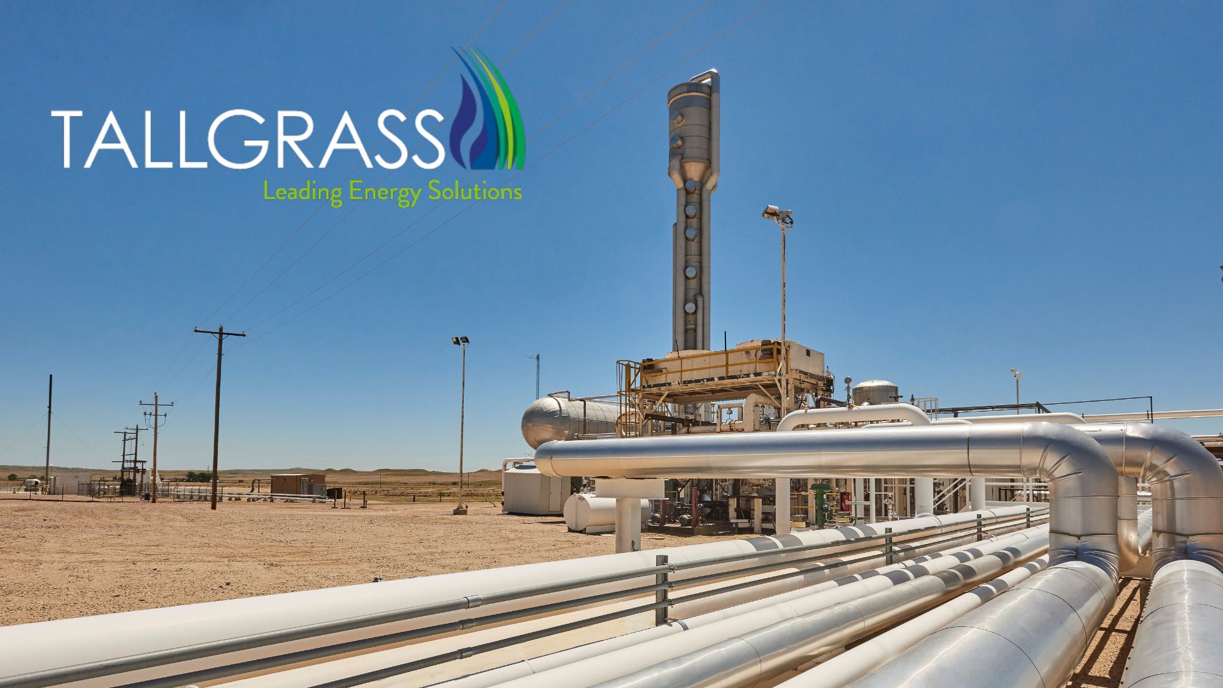
External Capacity Release - Reports

Slide 2
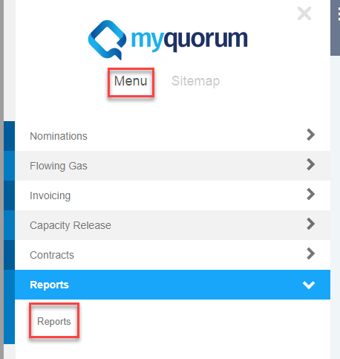
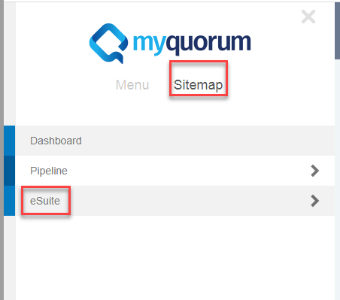
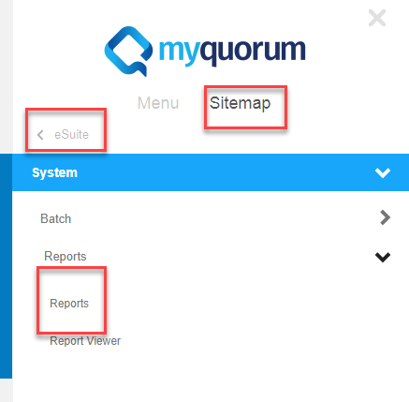
System
Via Menu
Reports
Reports
Via Sitemap
Reports
Reports
Report Viewer

Slide 3
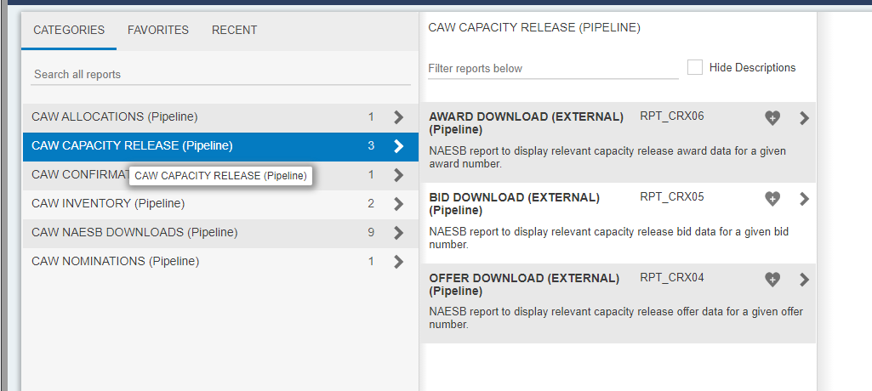
Reports
For the purposes of Contracts, the main Report you will access is the tied to the Capacity Release process: CAW Capacity Release (Pipeline)

Slide 4
Reports
The report you will most likely run is the Award Download, just highlight the report and the query screen will show up on the right side.
Use the pick list by clicking on the magnifying glass icon to query by Offer #.

Slide 5
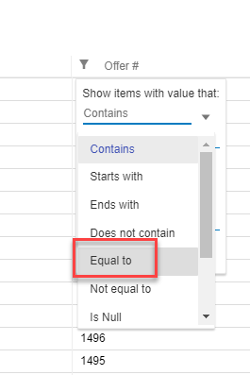
Reports
Click on the filter icon in the new pop up window.
From here you can choose how you want to Query. For Offers, choose Equal To for narrowing the query to the exact Award you are
looking for.

Slide 6
Reports
Once you have filled out your query it will look like this:

Slide 7
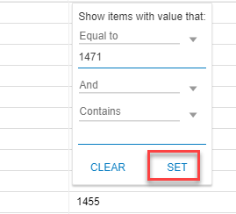
Reports
Then click on Set or hit Enter
And you should have one line with your Award #, Offer #, and Bid #.

Slide 8
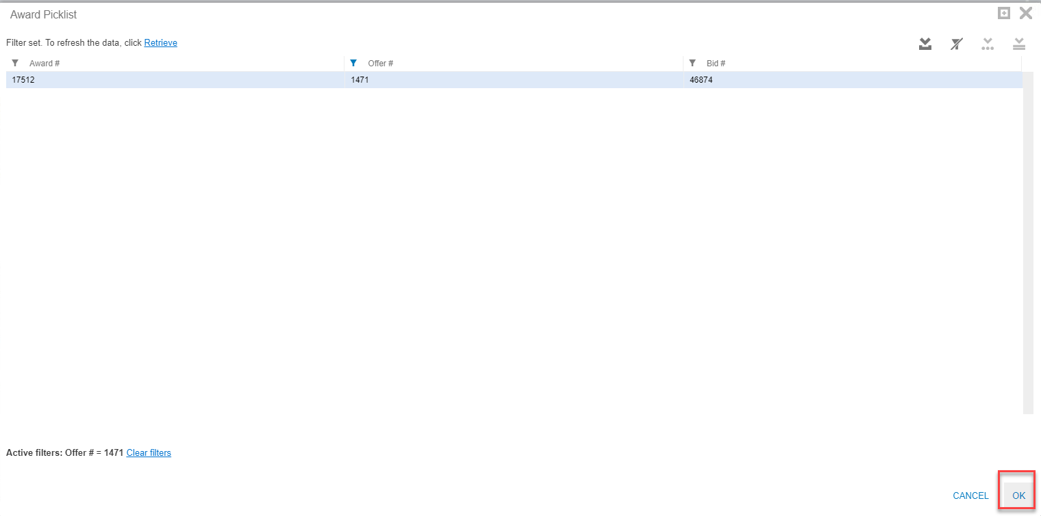
Reports
Highlight the line and click Ok

Slide 9
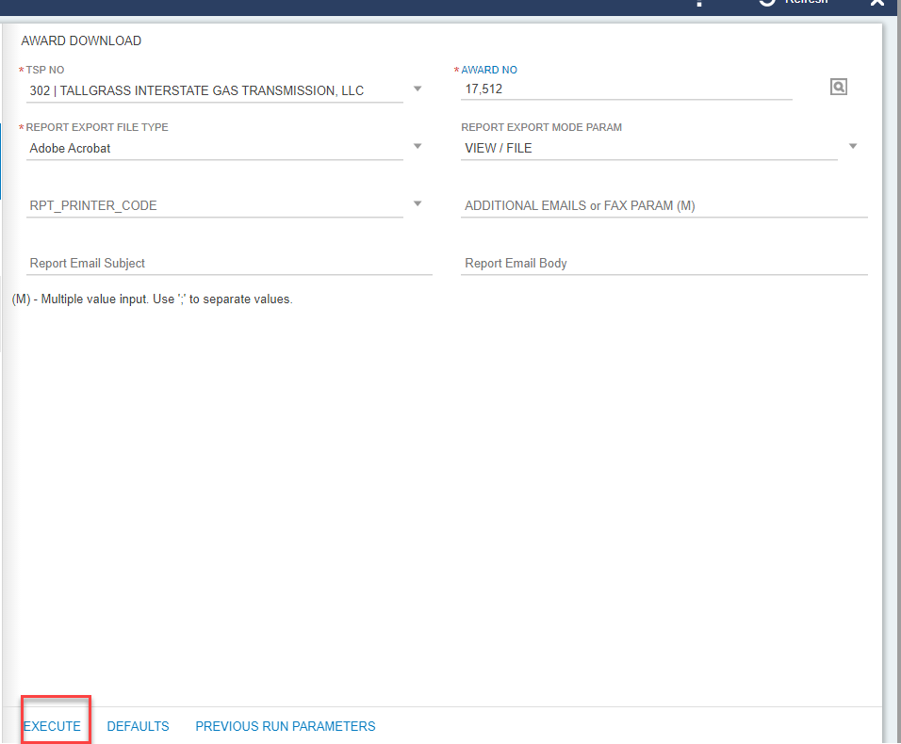
Reports
Query field is now populated hit Execute in the bottom of the Query

Slide 10
Reports
You will get notification in the bottom right corner that your Award Download is ready

Slide 11
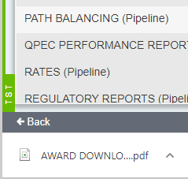
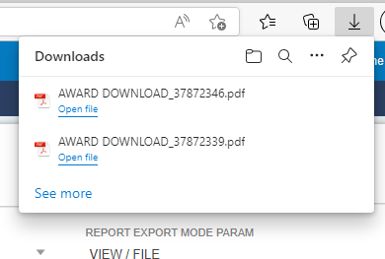
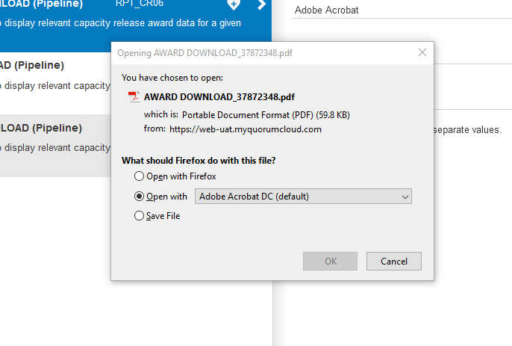
Reports
Depending on the browser you utilize the download report will show up in different areas of your screen to open:
Chrome lower left corner
Edge upper right corner
Firefox center screen

Slide 12
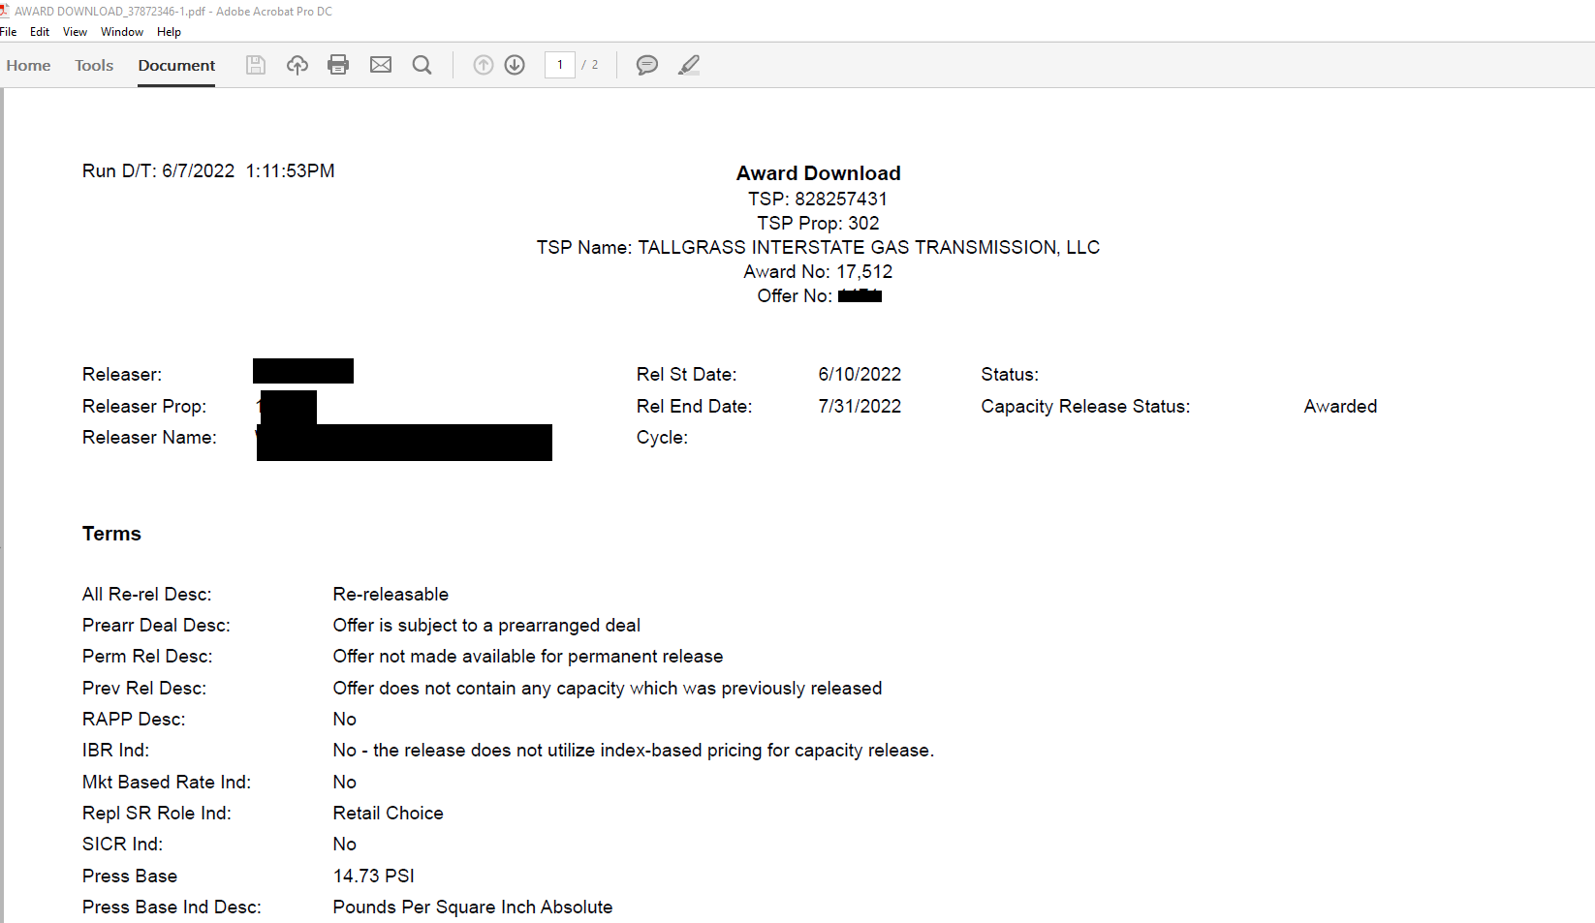
Reports
Report will appear as it does today in PDF form.

